Slide 1
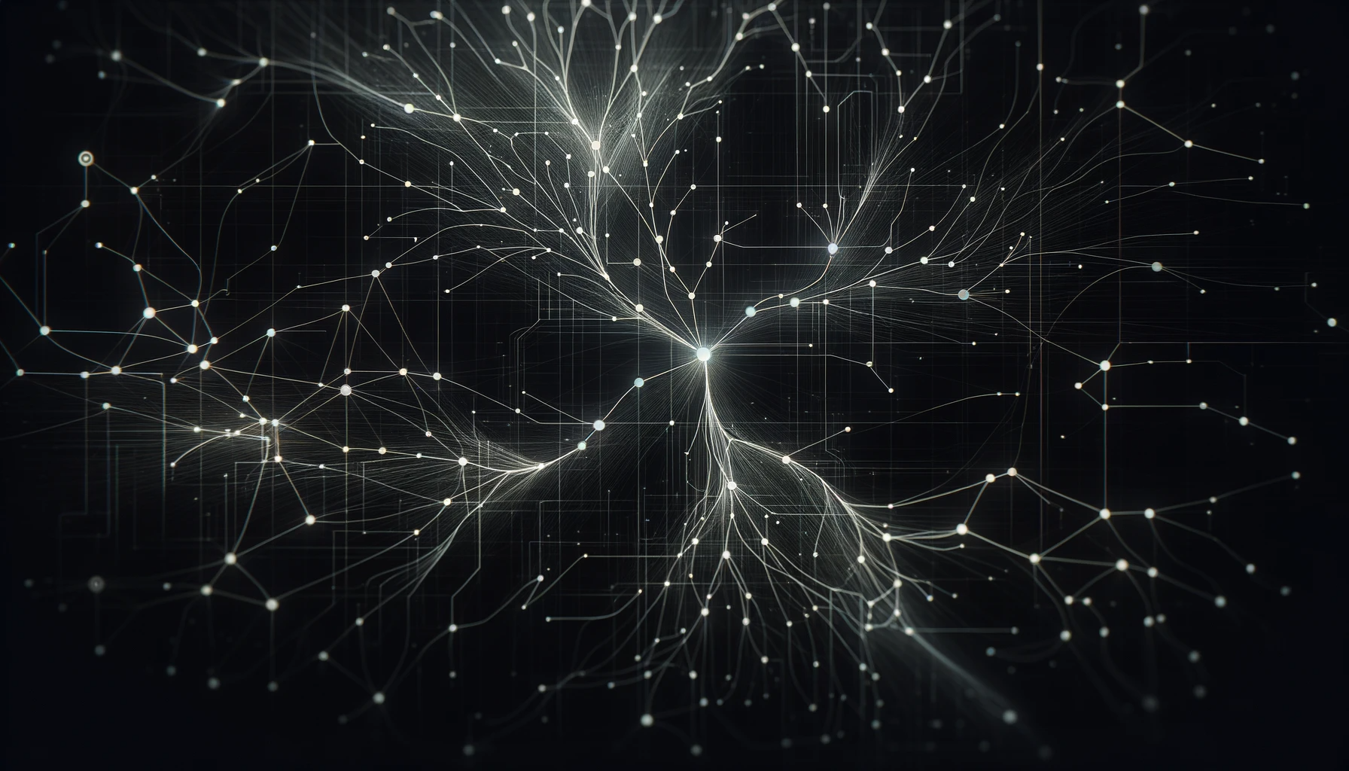
Introduction
Benchmarking Regularizations
Transfer Learning, weights=models.ResNet152_Weights.IMAGENET1K_V2
Custom dataset, a combination of five different public datasets.
The pre-trained was frozen, only FC optimized.
Tuned Dropout probability and Batch Normalization, trained ten models.
CUDA Device, RTX 3050 Ti 4 GB.
Reproducible results, i.e., deterministic code, random seed: 42
All the models without batch normalization outperformed.
Early stopping saved 8774 epochs.
Dropout: 0.2, BN: False won the benchmark.
Dropout: 0.0, BN: True lost it.
The best validation accuracy reached 97.50%.

Slide 2
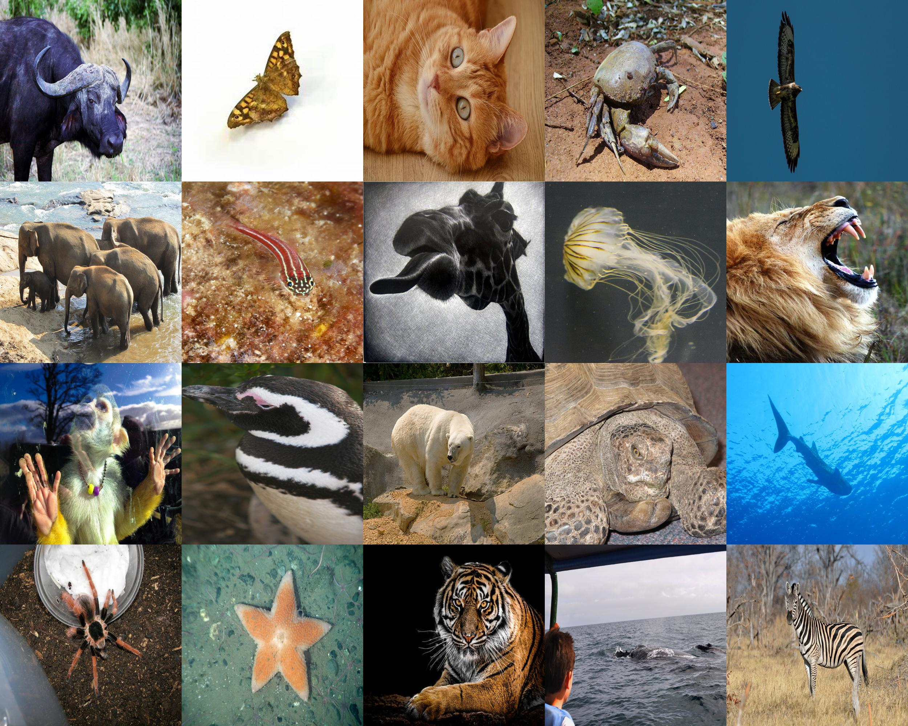
Dataset Statistics
Size: 1.37 GB
Number of samples: 5000
Number of classes: 20
Split Ratio: 80:20 (Stratify)
Classes: {buffalo, butterfly, cat, crab, eagle, elephant, fish, giraffe, jellyfish, lion, monkey, penguin, polar_bear, sea_turtle, shark, spider, starfish, tiger, whale, zebra}
Kaggle Datasets
African Wildlife
Animal Image Dataset(DOG, CAT and PANDA)
Animals Detection Images Dataset
Animals-10
Wildlife Animals Images

Slide 3
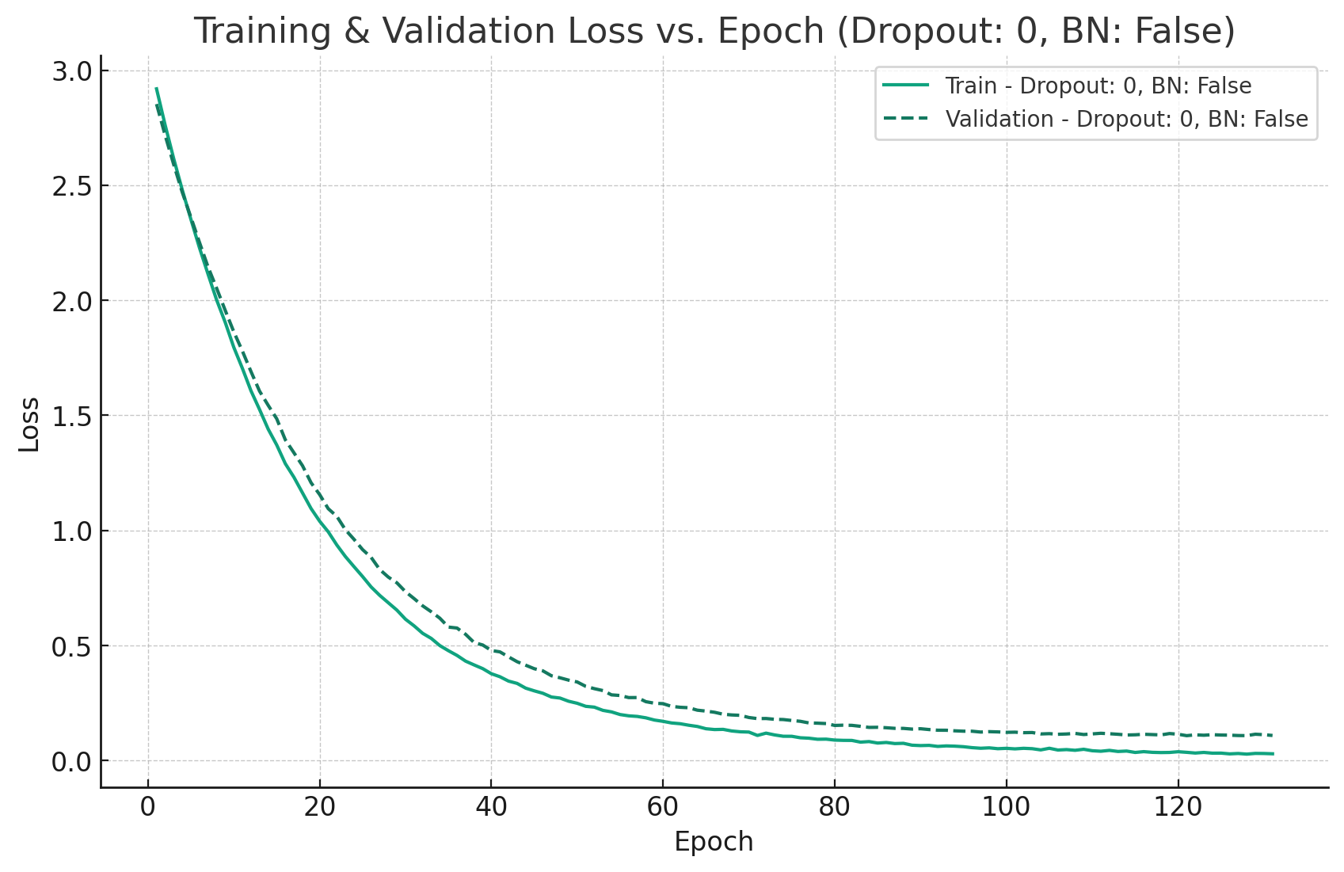
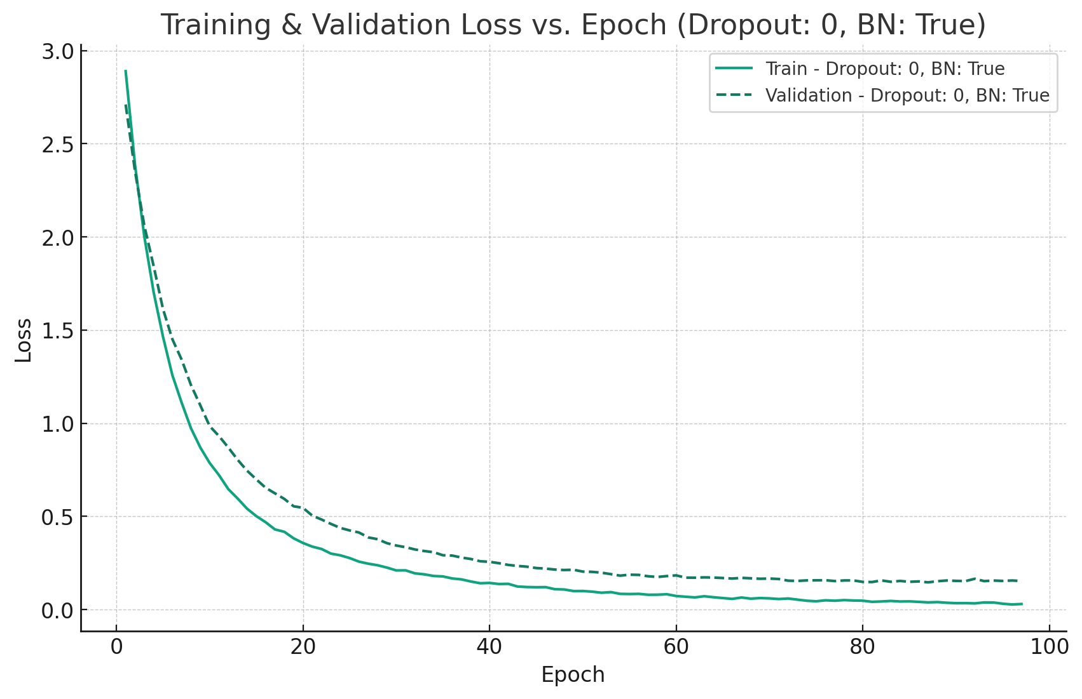
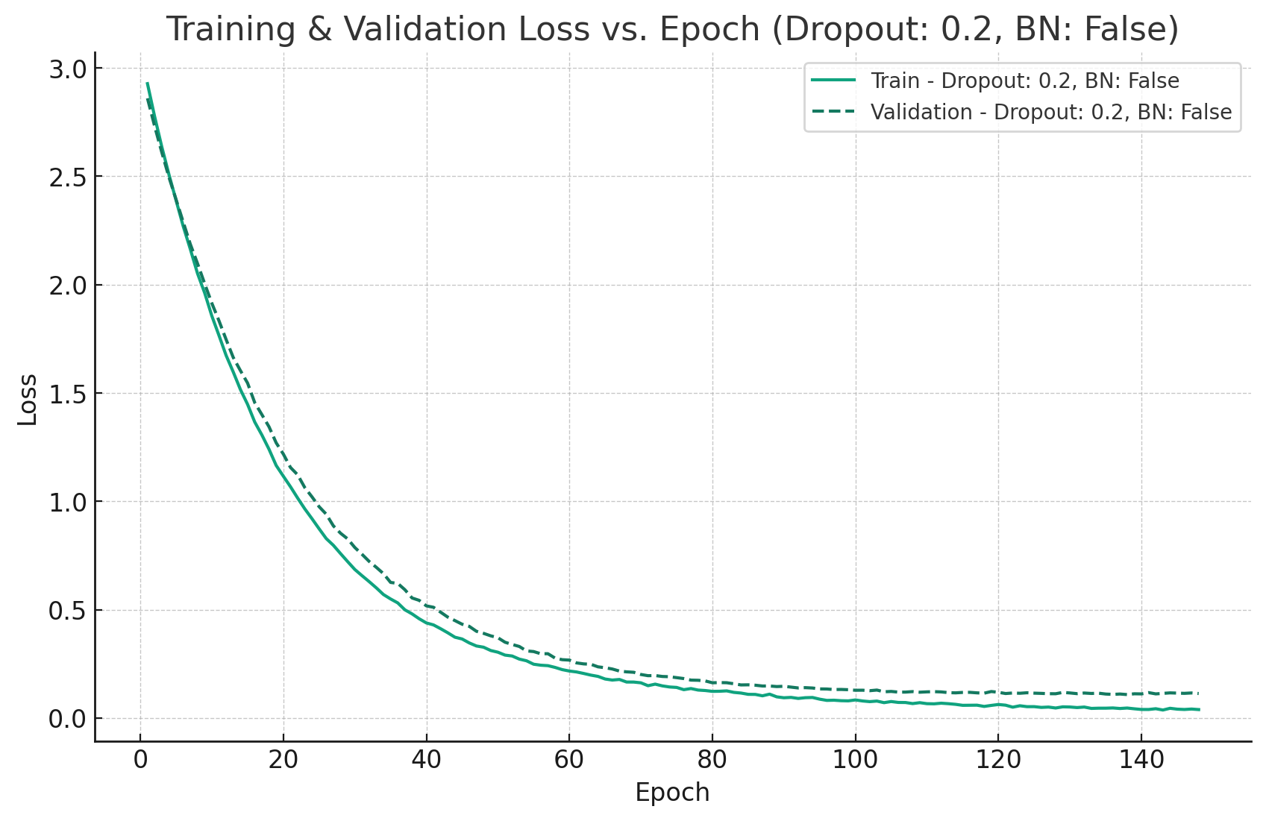
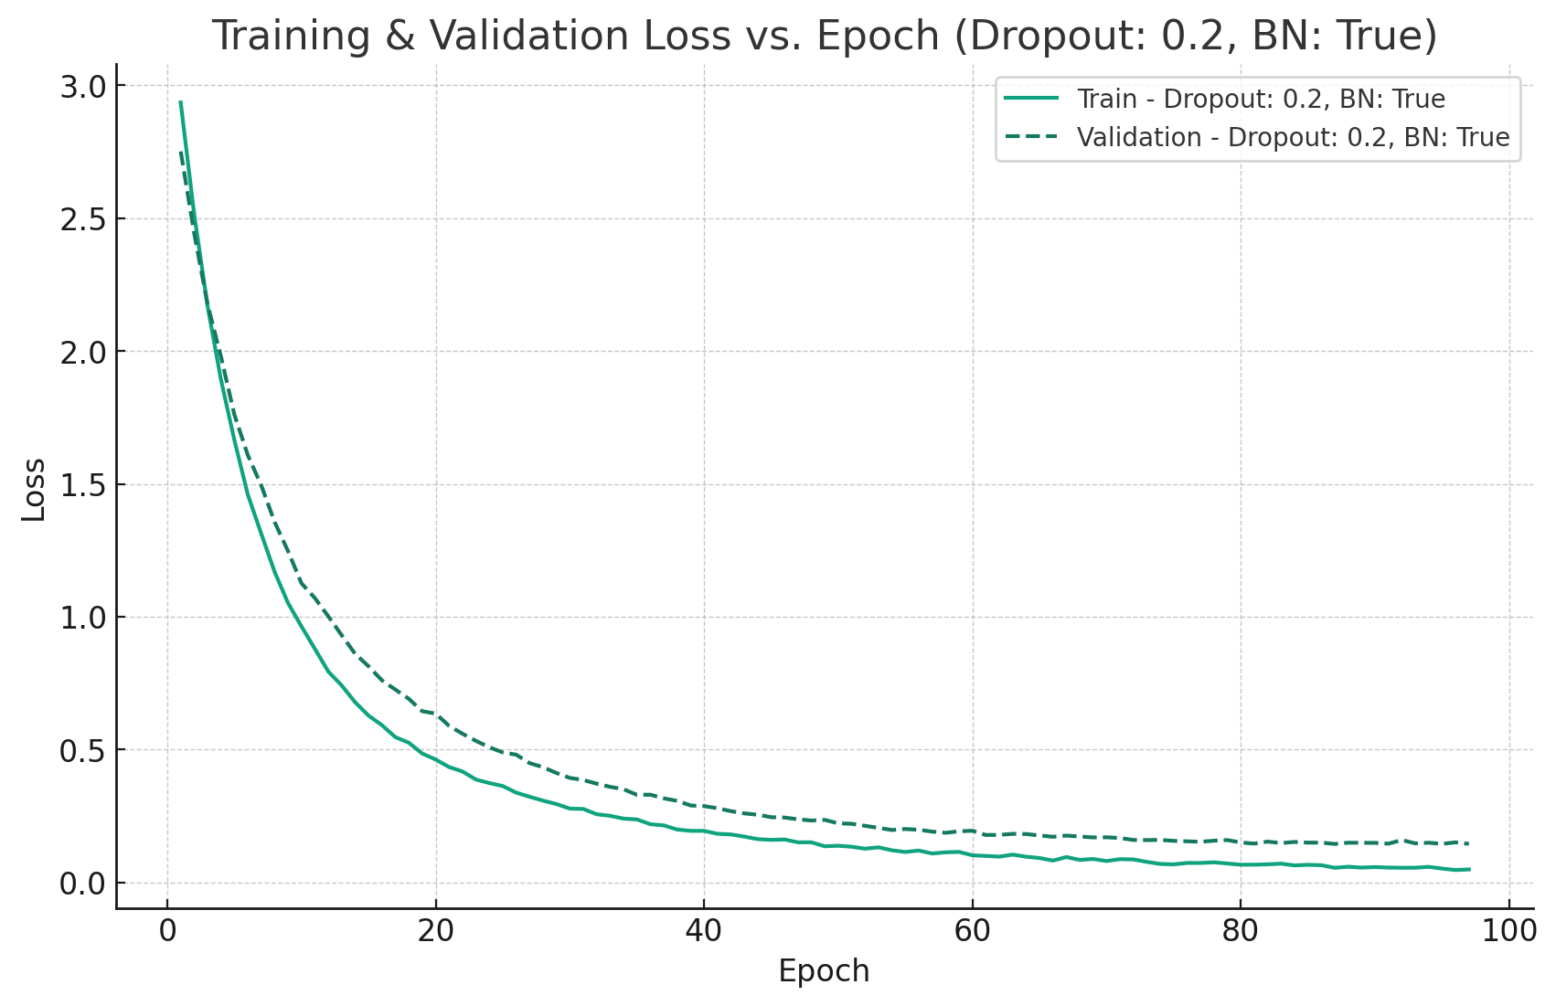
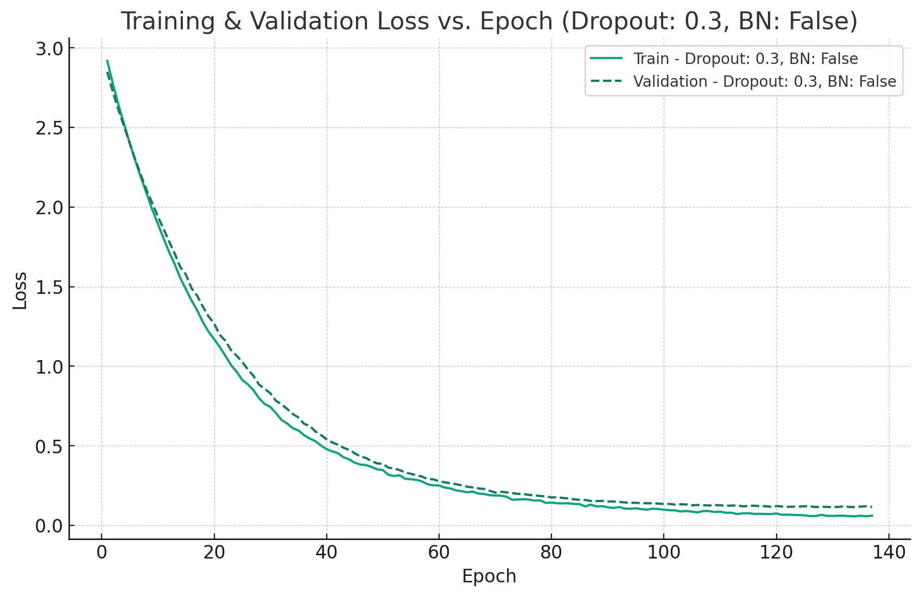
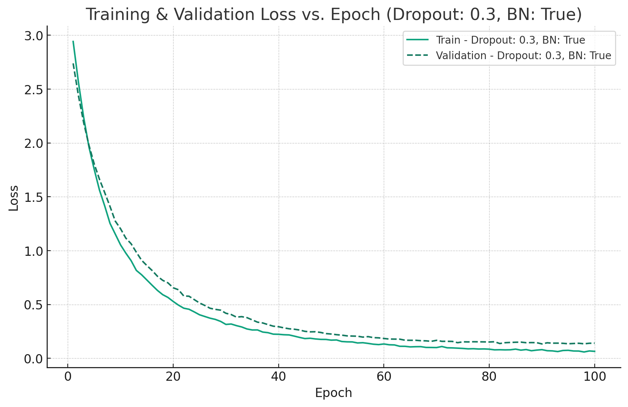
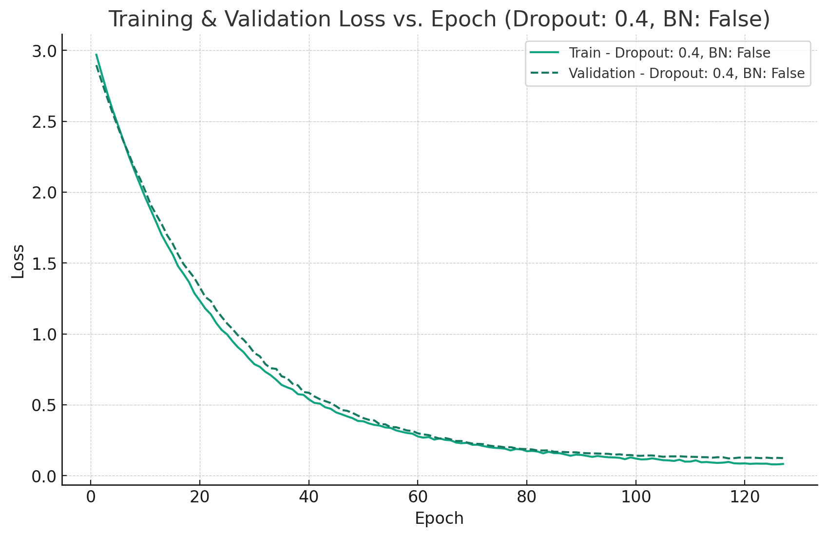
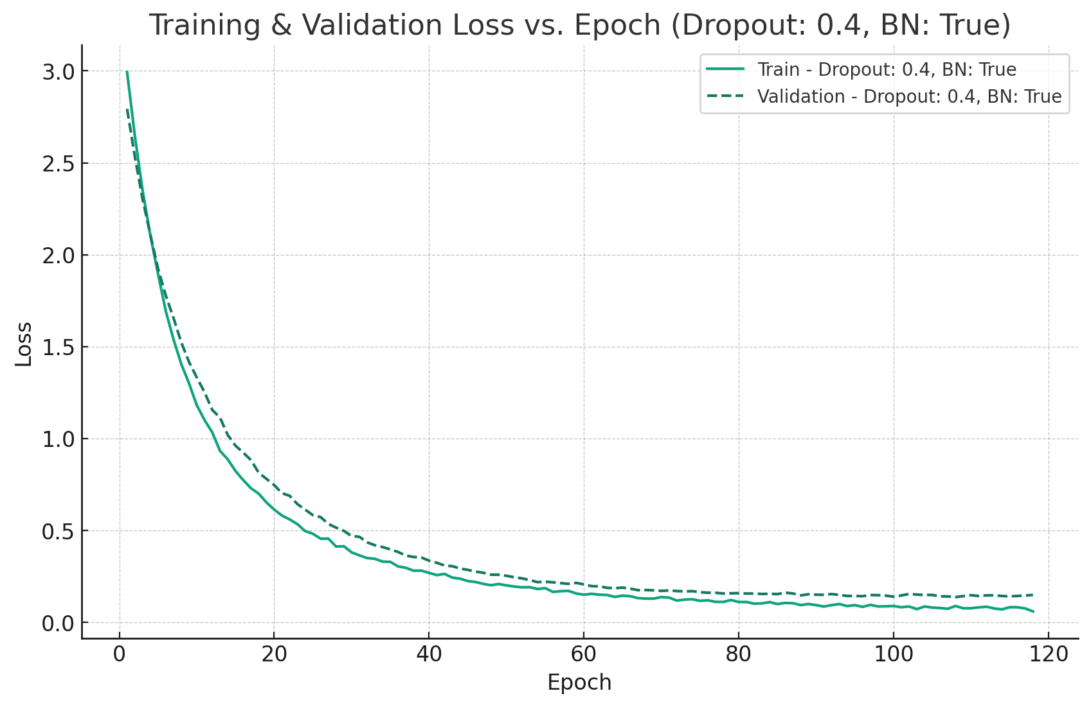
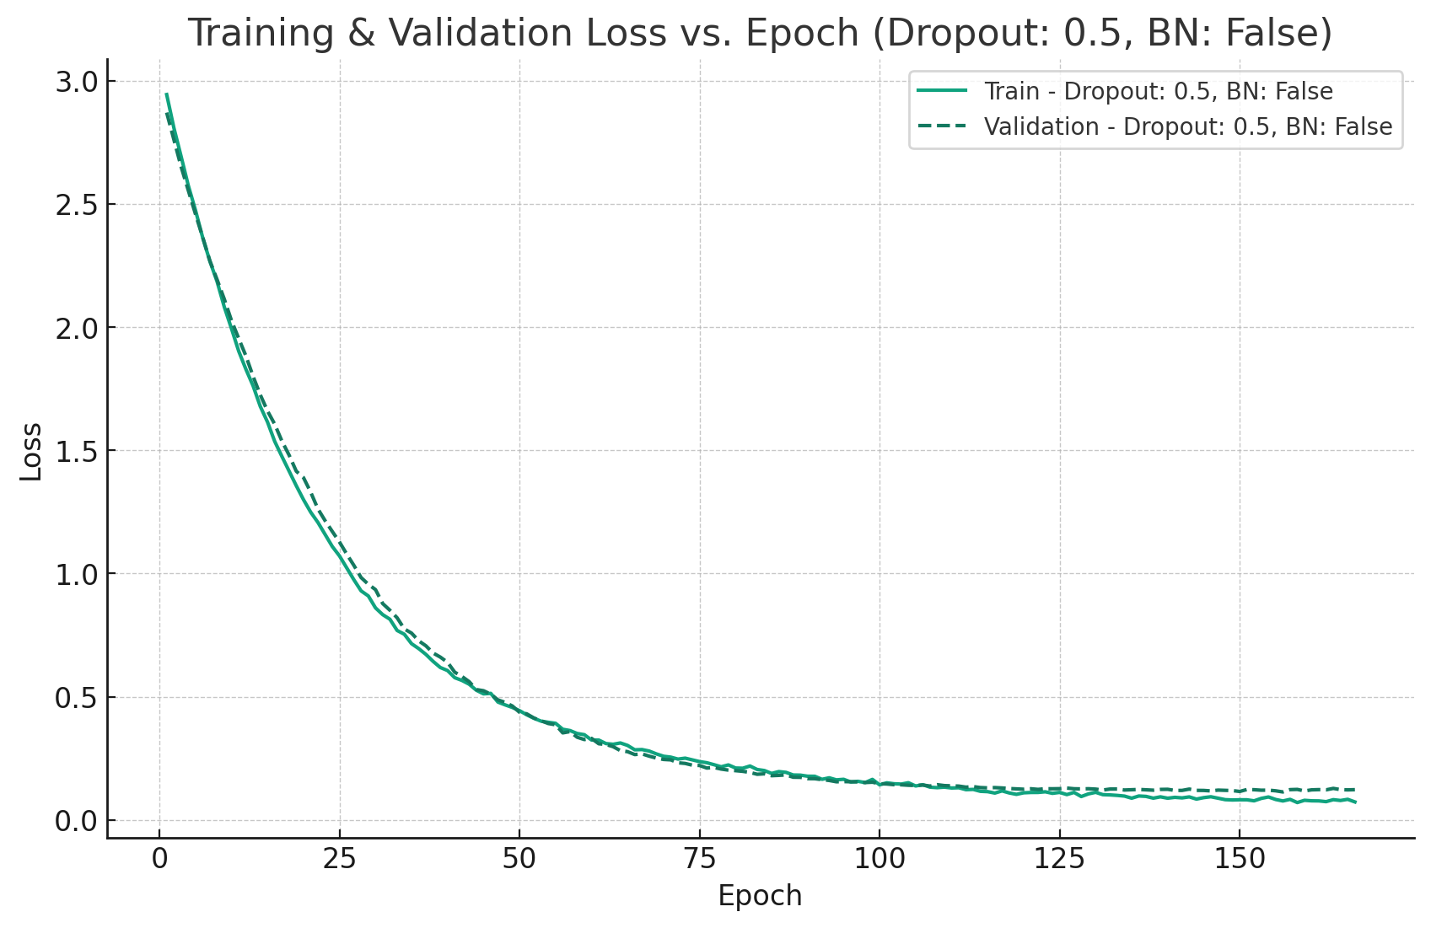
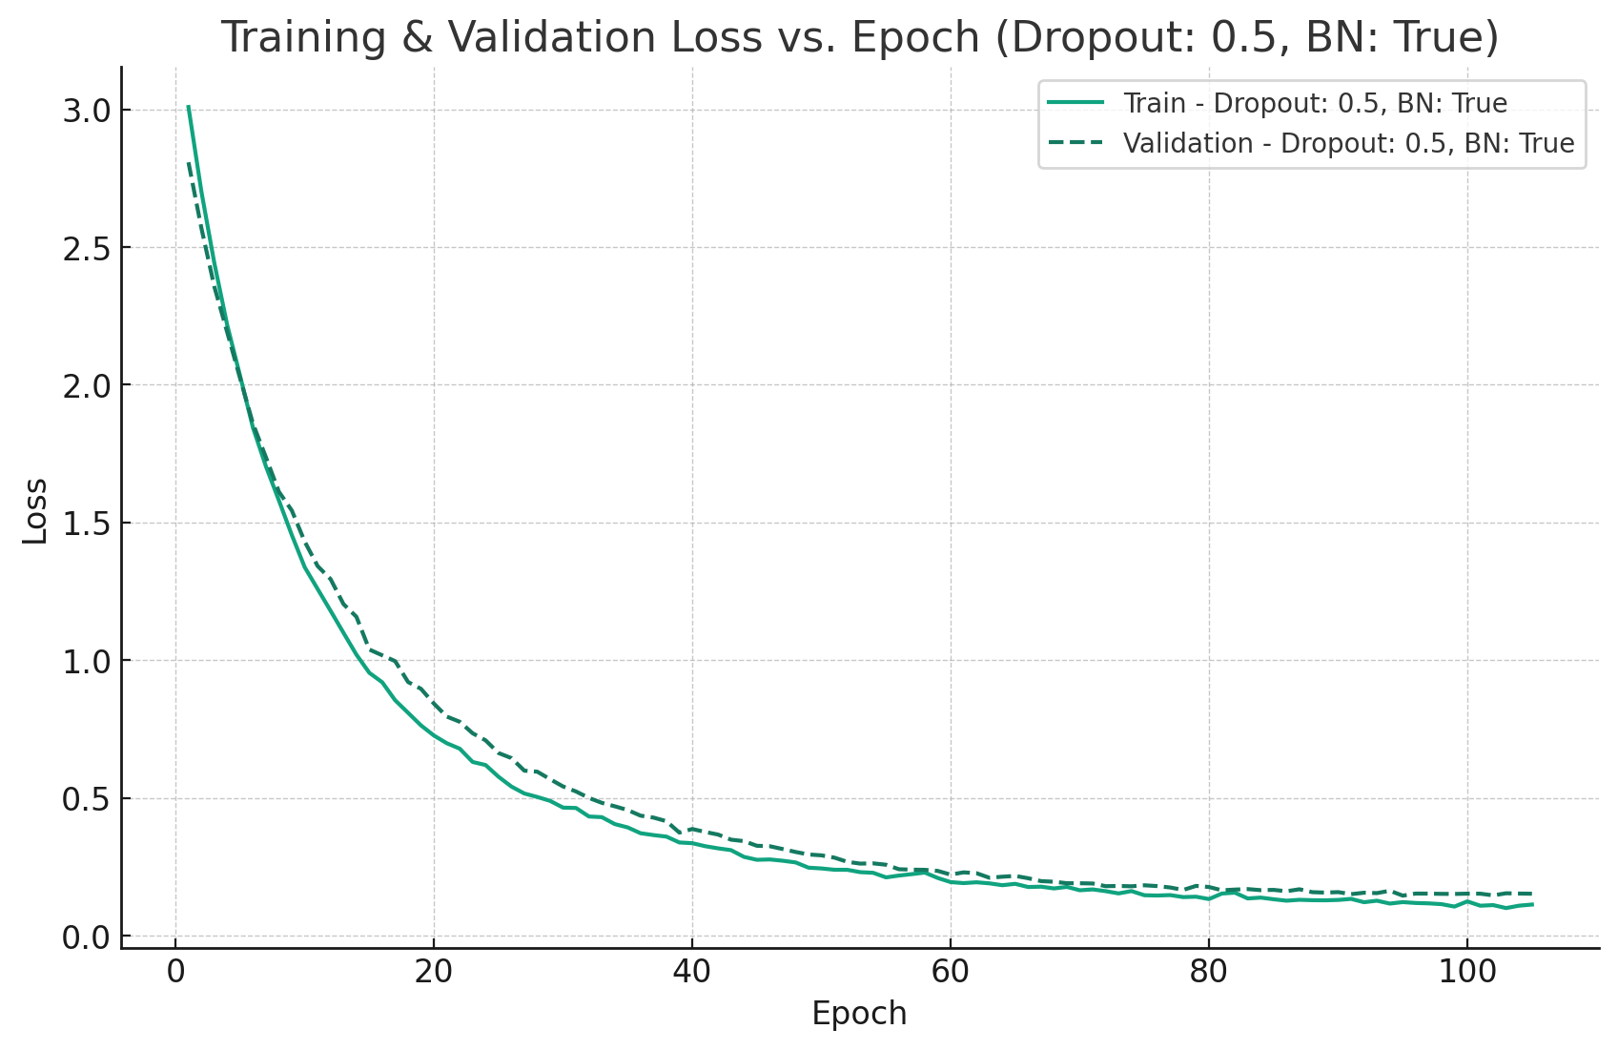
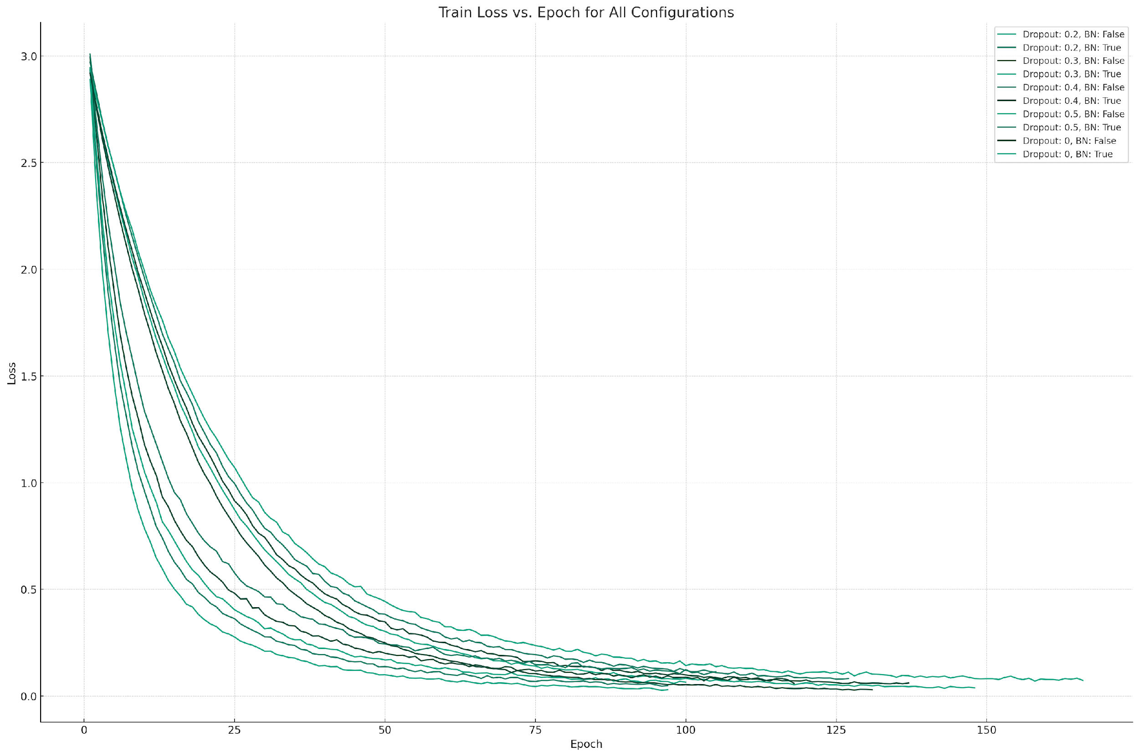
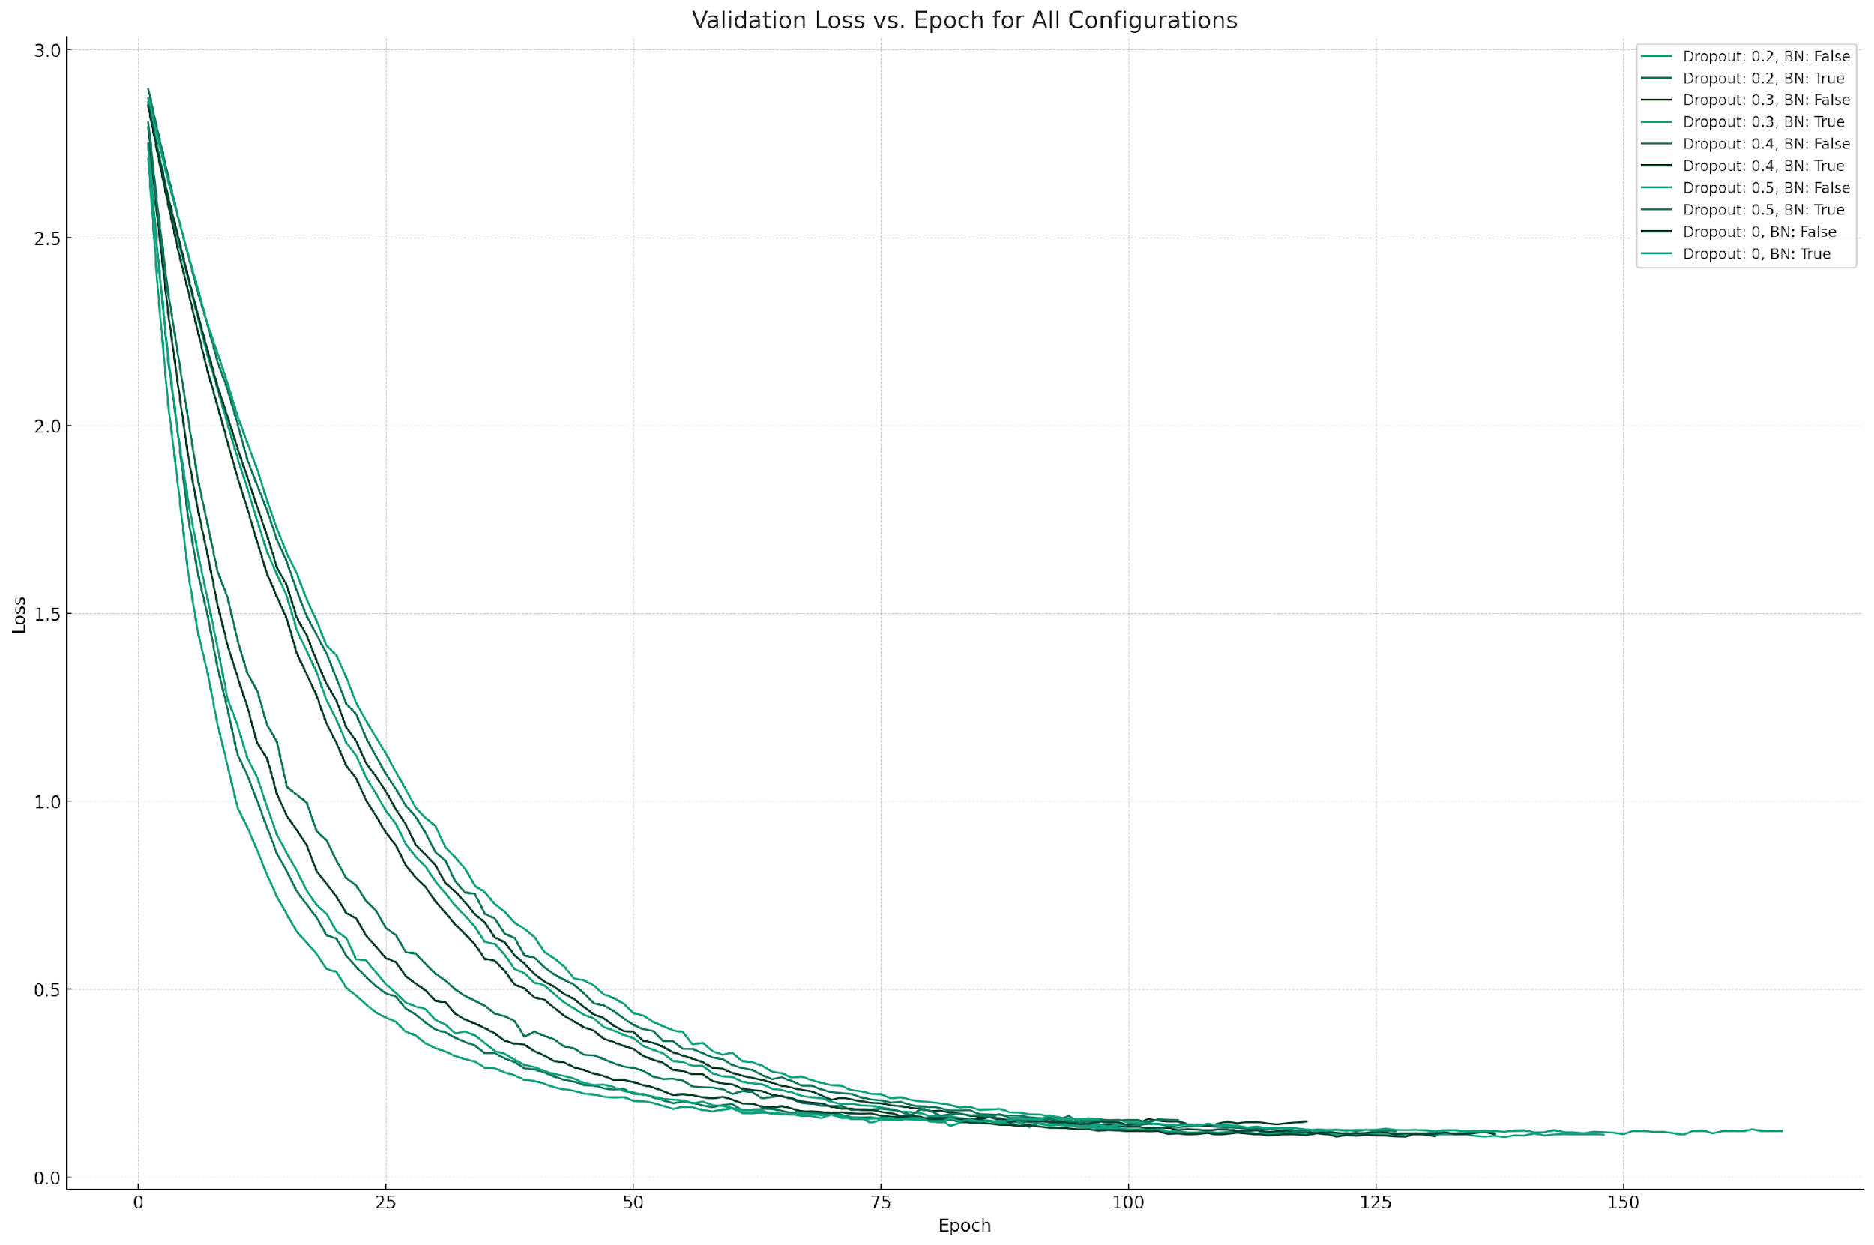
Training Curves

Slide 4
Training Stats
Dropout | Batch Normalization | Training Time (s) | Average Epoch Time (s) | Epochs
0.0 | False | 13787.924220 | 105.2513299240 | 131
0.0 | True | 09901.089469 | 102.0730873090 | 097
0.2 | False | 15134.800950 | 102.2621685810 | 148
0.2 | True | 09905.298426 | 102.1164786190 | 097
0.3 | False | 14270.343040 | 104.1630878830 | 137
0.3 | True | 10167.154950 | 101.6715495000 | 100
0.4 | False | 13105.720980 | 103.1946533860 | 127
0.4 | True | 12317.889710 | 104.3888958470 | 118
0.5 | False | 16547.751120 | 099.6852477108 | 166
0.5 | True | 10455.914740 | 099.5801403810 | 105
Total / Average = |  | 125593.887605 ≈ 35h | 102.43866391408 | 1226

Slide 5
Regularization & Optimization
Regularization
Dropout
Between Final Input Features & BN
Probabilities: 0.0, 0.2, 0.3, 0.4, 0.5
Batch Normalization
Between BN & FC
False, True
Early Stopping
Initial Epochs = 1000
Patience Epochs = 10
Data Augmentation
Random Resized Crop
Random Horizontal Flip
Random Rotation
Color Jitter
Optimization
Mini Batch SGD
Adam
Batch Size = 64
Learning Rate Scheduling
OneCycleLR
Maximum Learning Rate = 0.001

Slide 6
Performance Metrics
Dropout | Batch Normalization | Epoch | Accuracy | Precision | Recall
0.0 | False | 121 | 0.975 | 0.975133335 | 0.975
0.0 | True | 087 | 0.964 | 0.964099568 | 0.964
0.2 | False | 138 | 0.975 | 0.975369150 | 0.975
0.2 | True | 087 | 0.966 | 0.966406526 | 0.966
0.3 | False | 127 | 0.974 | 0.974438370 | 0.974
0.3 | True | 090 | 0.971 | 0.971513341 | 0.971
0.4 | False | 117 | 0.969 | 0.969339367 | 0.969
0.4 | True | 108 | 0.967 | 0.967104320 | 0.967
0.5 | False | 156 | 0.973 | 0.973155326 | 0.973
0.5 | True | 095 | 0.965 | 0.965096725 | 0.965

Slide 7
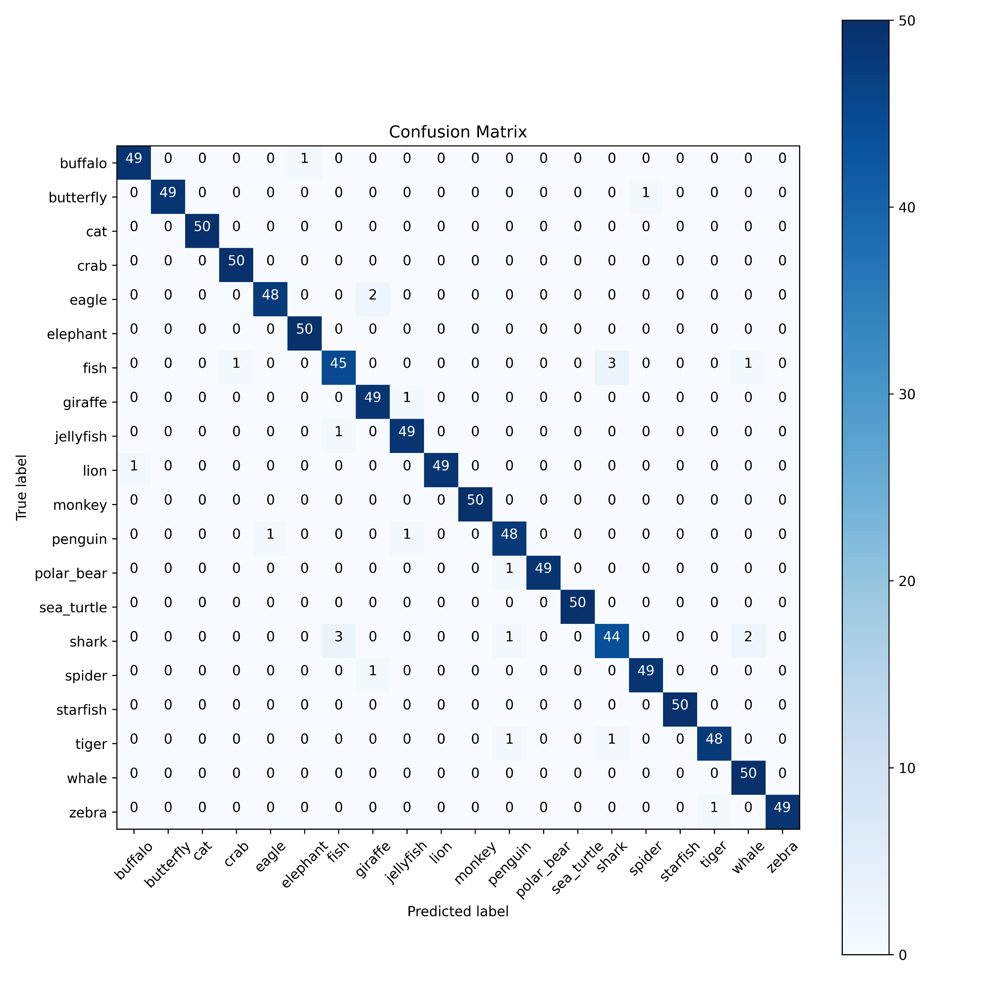









Confusion Matrices
Dropout: 0.0, BN: False
Dropout: 0.2, BN: False
Dropout: 0.3, BN: False
Dropout: 0.4, BN: False
Dropout: 0.5, BN: False
Dropout: 0.0, BN: True
Dropout: 0.2, BN: True
Dropout: 0.3, BN: True
Dropout: 0.4, BN: True
Dropout: 0.5, BN: True

Slide 8
Introduction
Benchmarking Regularizations
Architecture: Squeeze-and-Excitation Networks with ResNet152
Fine-tuned full network.
Early stopping saved 9530 epochs.
Dropout: 0.3, BN: False won the benchmark.
Dropout: 0.4, BN: False lost it.
The best validation accuracy reached 53.9%.

Slide 9
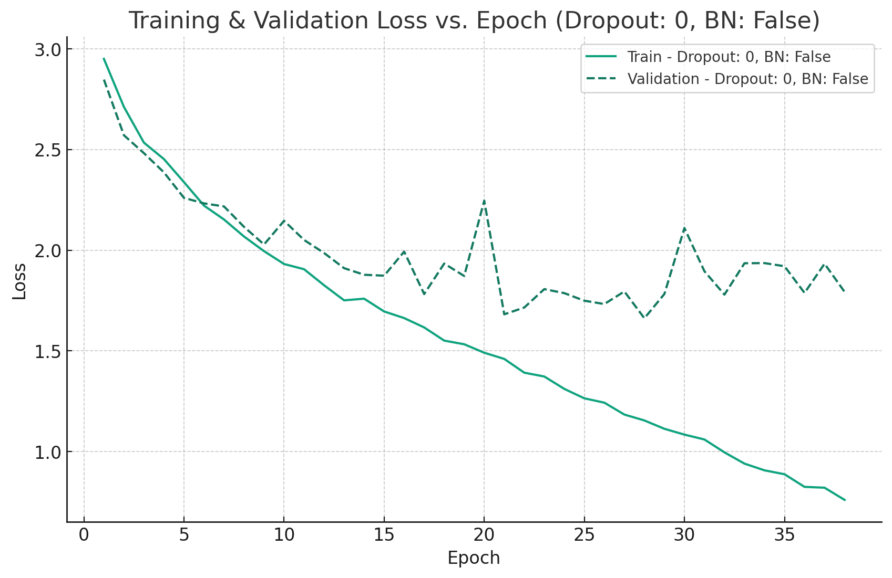
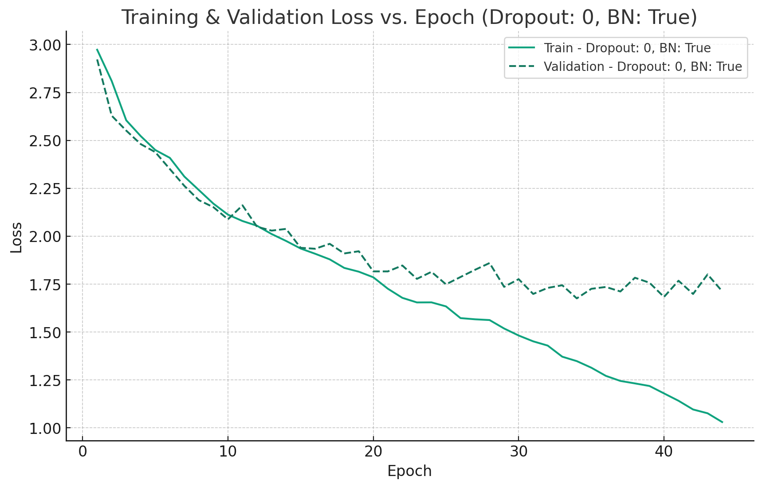
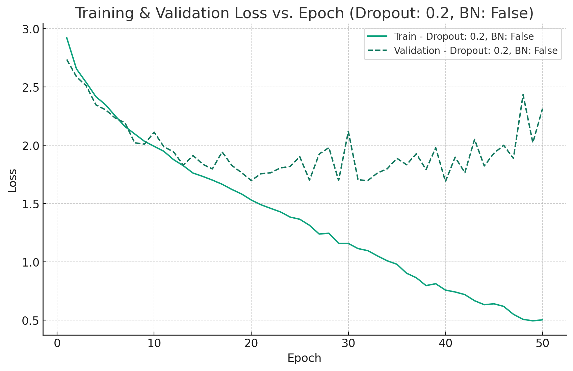
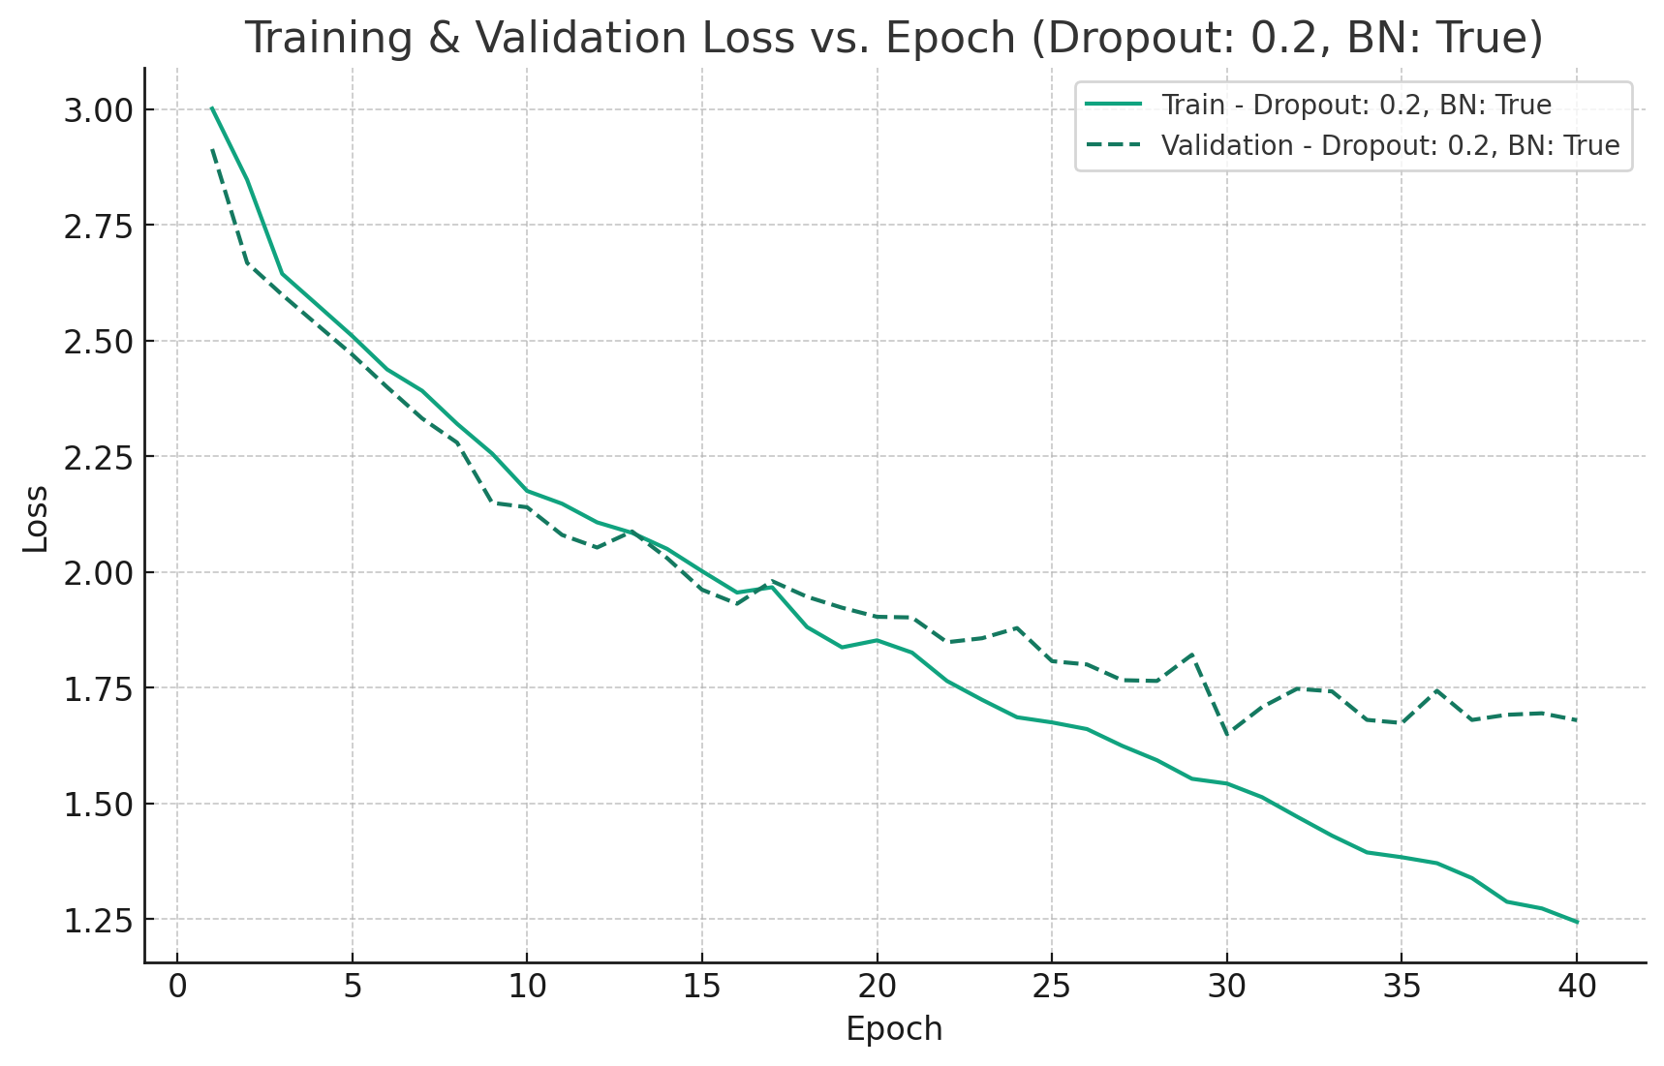
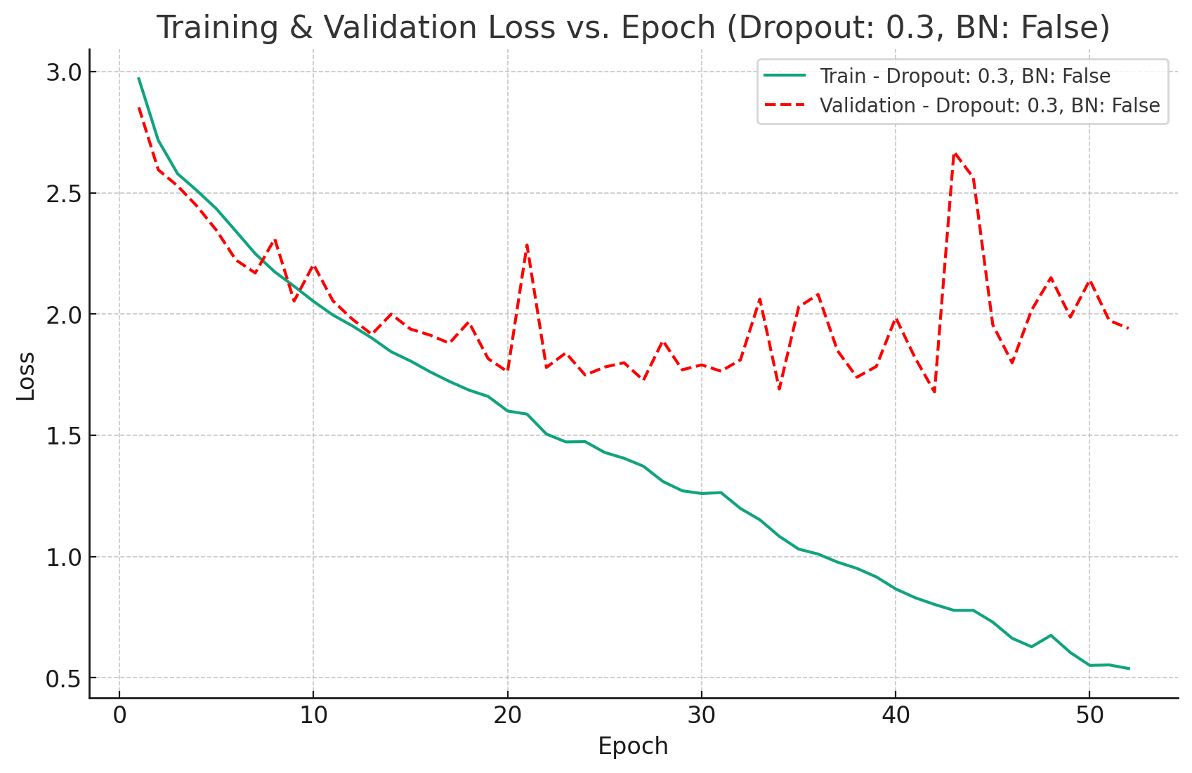
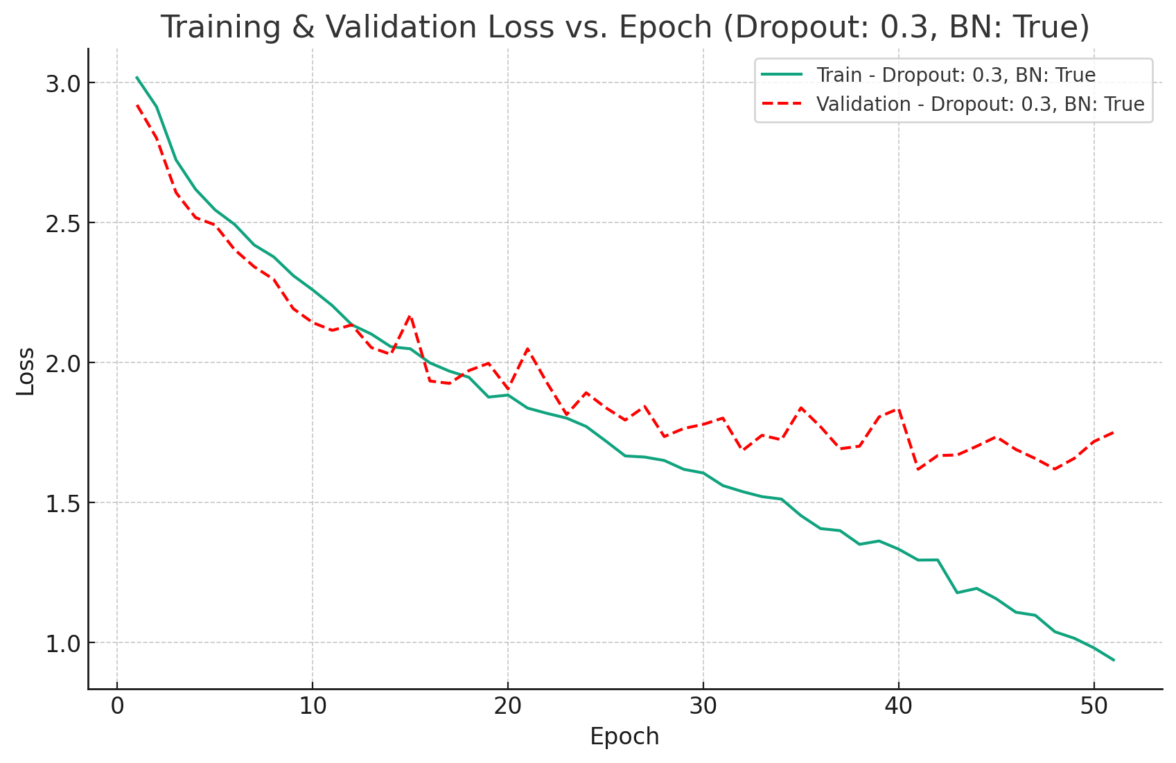
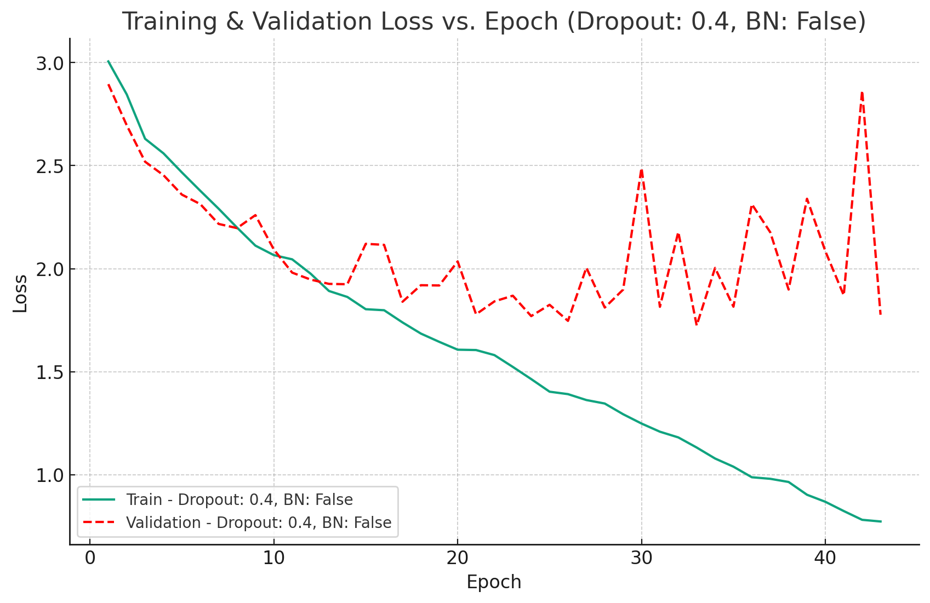
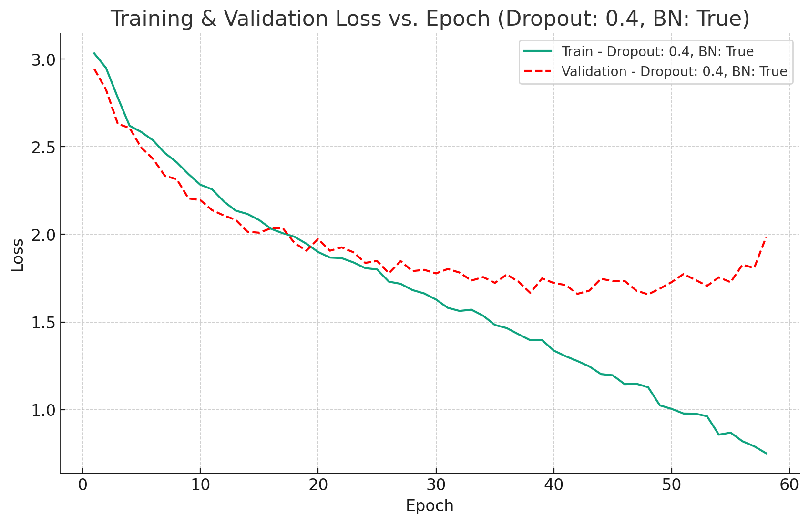
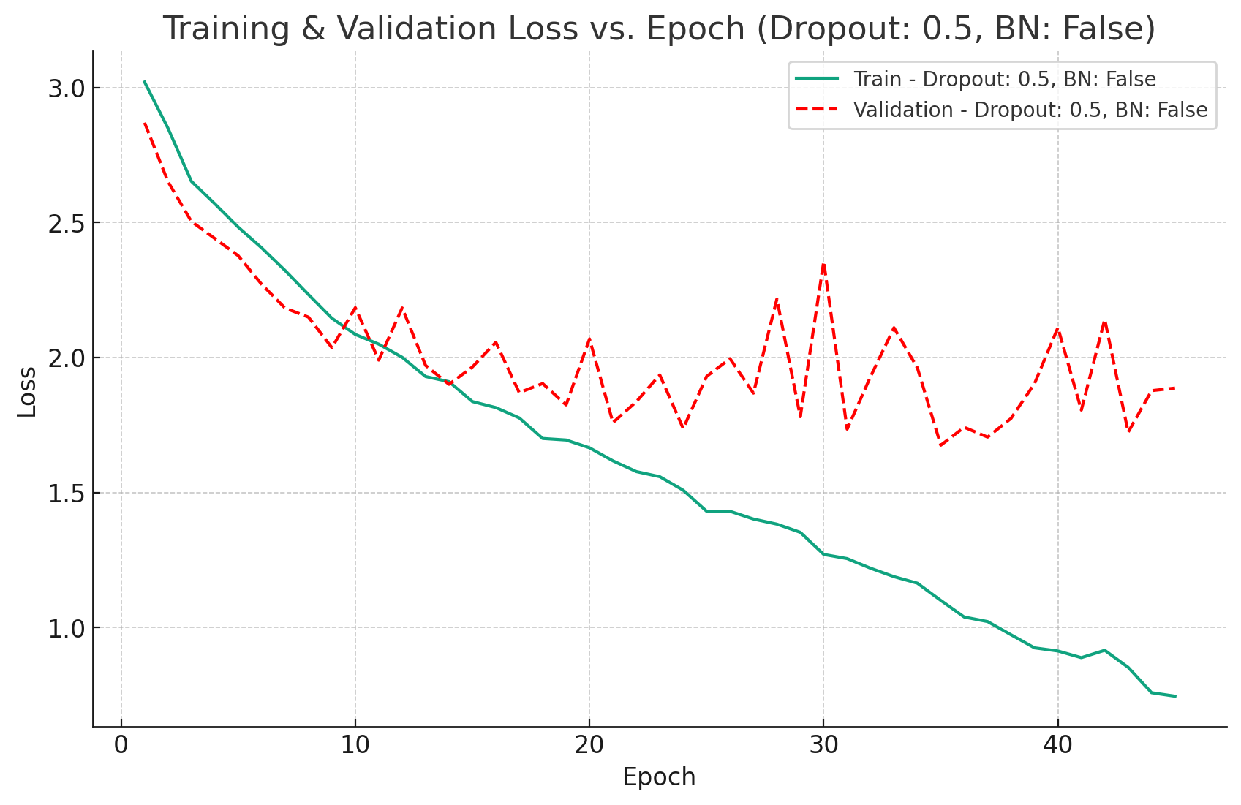
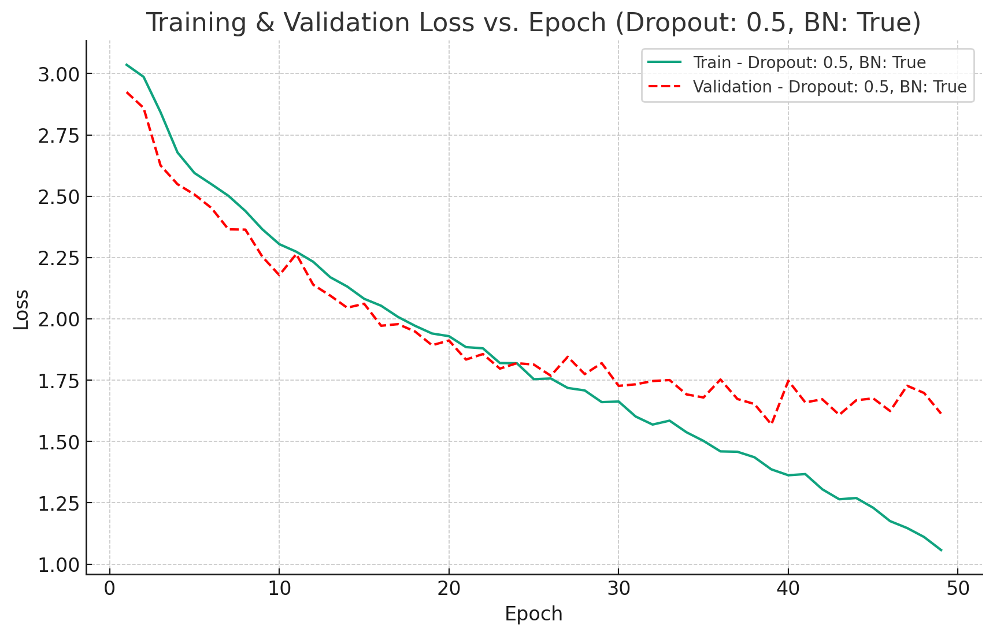
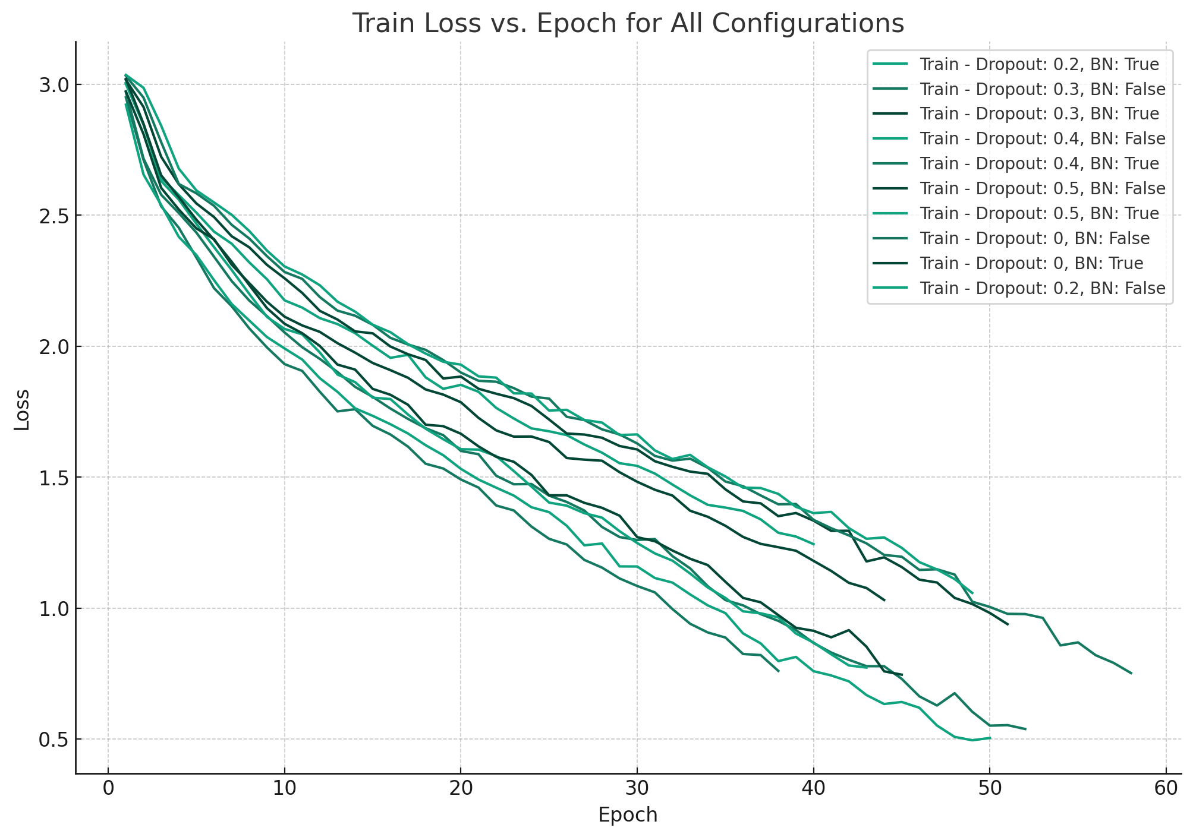
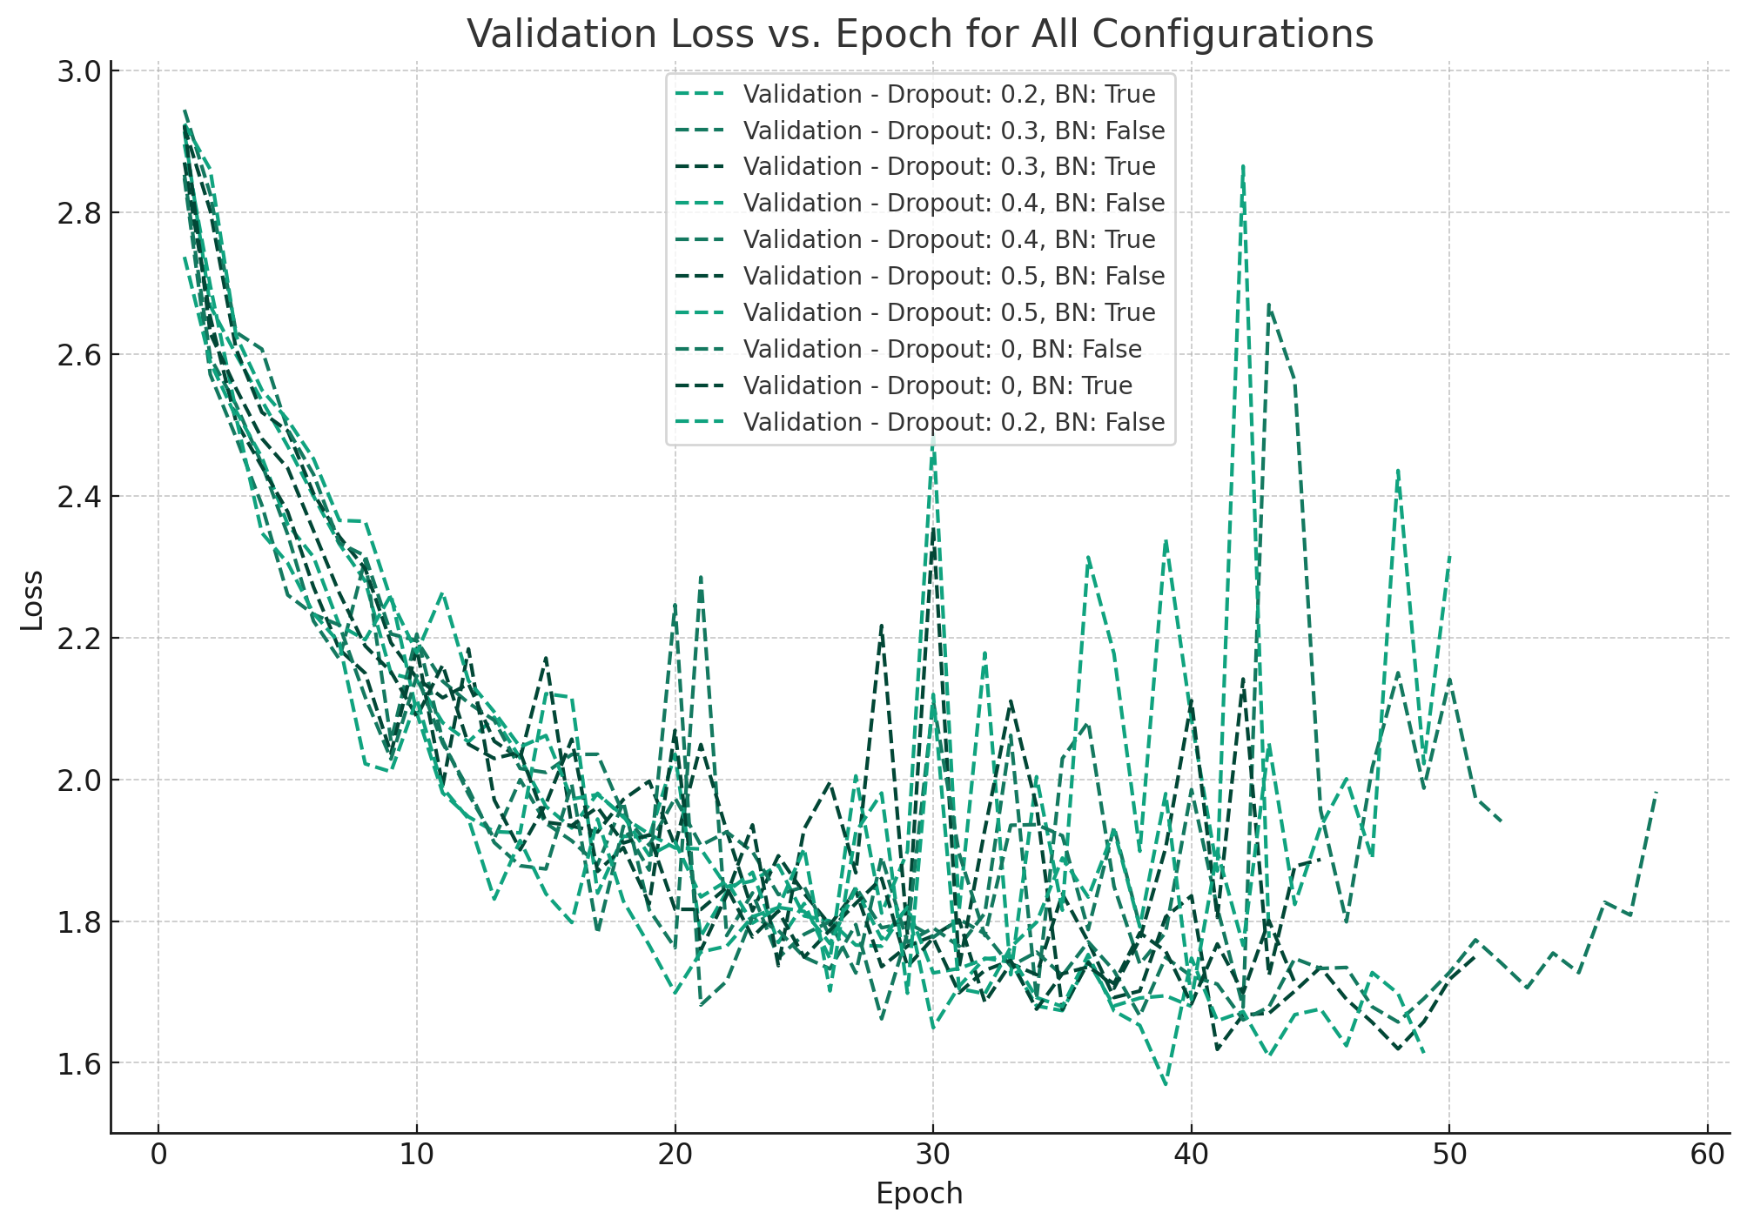
Training Curves

Slide 10
Training Stats
Dropout | Batch Normalization | Training Time (s) | Average Epoch Time (s) | Epochs
0.0 | False | 088411.69763 | 2326.62362184 | 38
0.0 | True | 112139.30530 | 2548.62057500 | 44
0.2 | False | 120340.90480 | 2406.81809600 | 50
0.2 | True | 103970.86940 | 2599.27173500 | 40
0.3 | False | 125154.23320 | 2406.81217692 | 52
0.3 | True | 131150.42850 | 2571.57702941 | 51
0.4 | False | 99734.47163 | 2319.40631698 | 43
0.4 | True | 149127.1583 | 2571.15790172 | 58
0.5 | False | 104992.1139 | 2333.15808667 | 45
0.5 | True | 123479.5489 | 2519.99079388 | 49
Total / Average = |  | 1281980.28046 ≈ 15d | 2460.343633342 | 470

Slide 11
Regularization & Optimization
Regularization
Batch Normalization
3 BN layers, each after conv

Slide 12
Performance Metrics
Dropout | Batch Normalization | Epoch | Accuracy | Precision | Recall
0.0 | False | 28 | 0.488 | 0.513466274 | 0.488
0.0 | True | 34 | 0.496 | 0.498935088 | 0.496
0.2 | False | 40 | 0.524 | 0.545607366 | 0.524
0.2 | True | 30 | 0.504 | 0.517430346 | 0.504
0.3 | False | 42 | 0.539 | 0.544515670 | 0.539
0.3 | True | 41 | 0.536 | 0.550808151 | 0.536
0.4 | False | 33 | 0.485 | 0.513477011 | 0.485
0.4 | True | 48 | 0.512 | 0.527334809 | 0.512
0.5 | False | 35 | 0.517 | 0.528795829 | 0.517
0.5 | True | 39 | 0.493 | 0.515908706 | 0.493

Slide 13
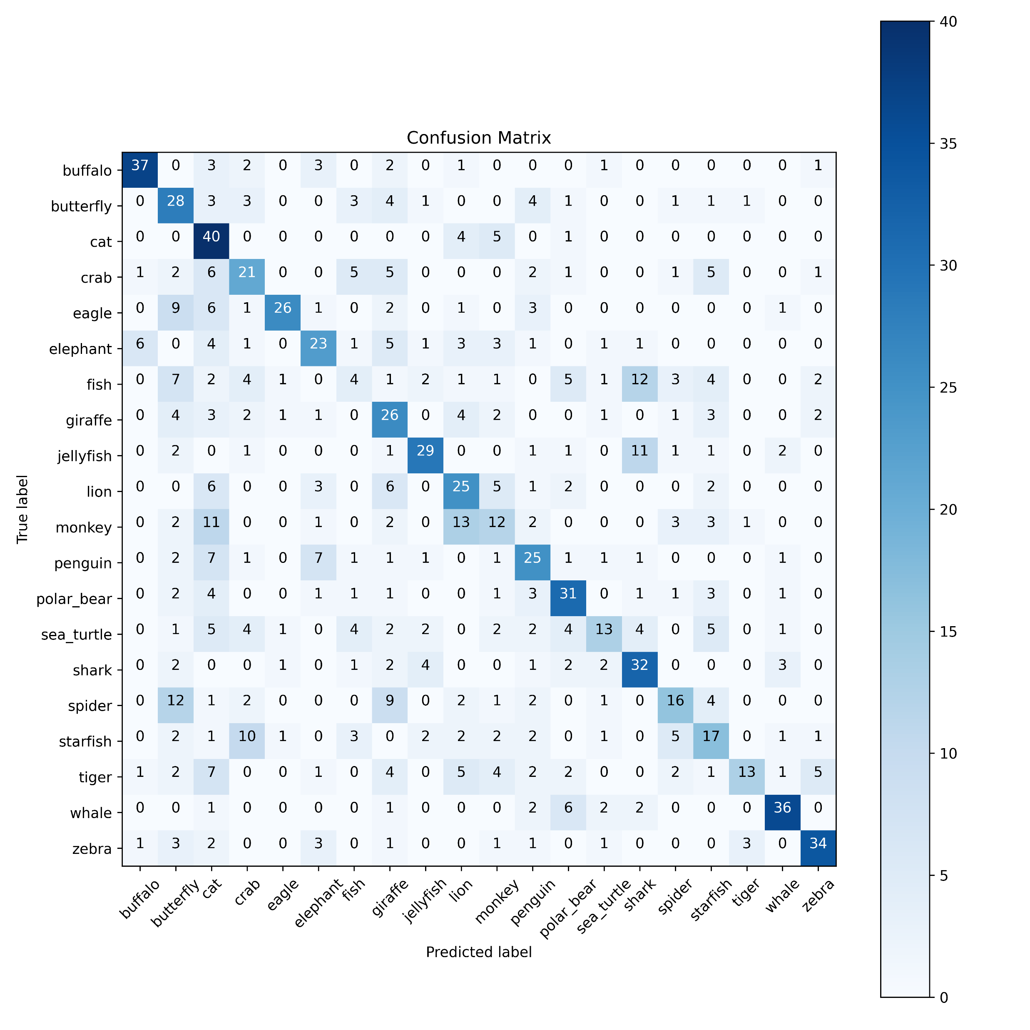
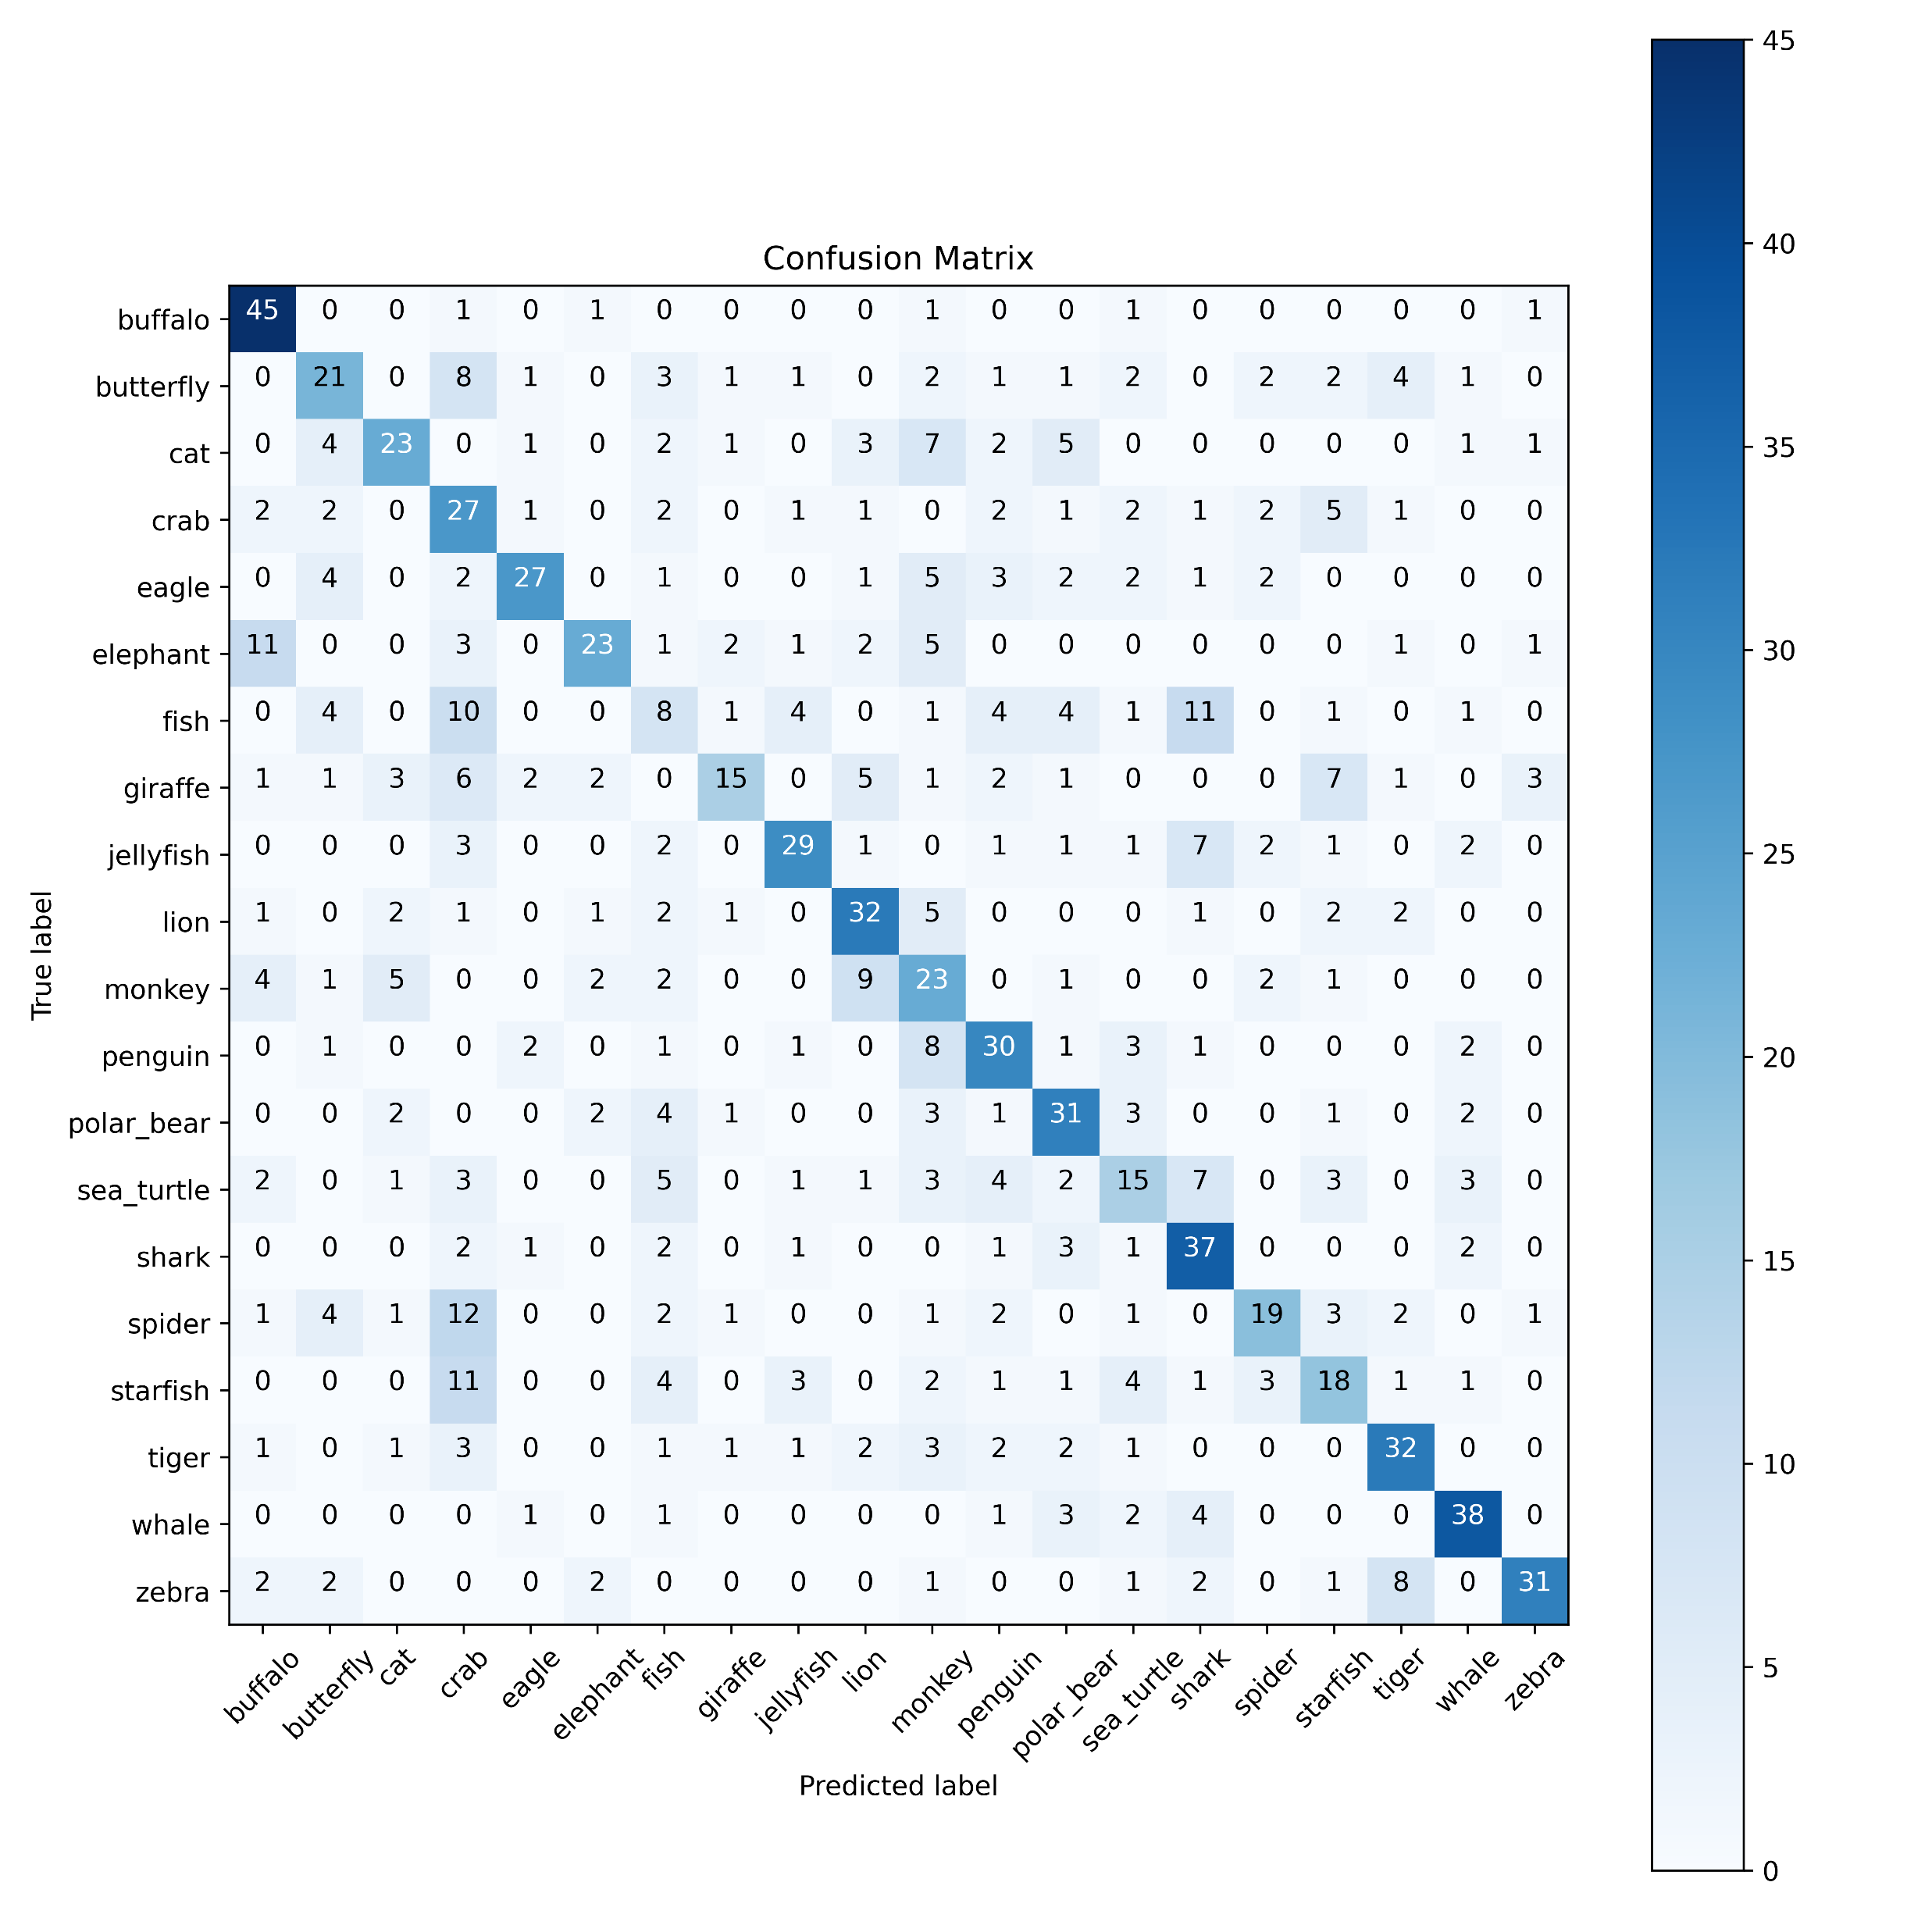
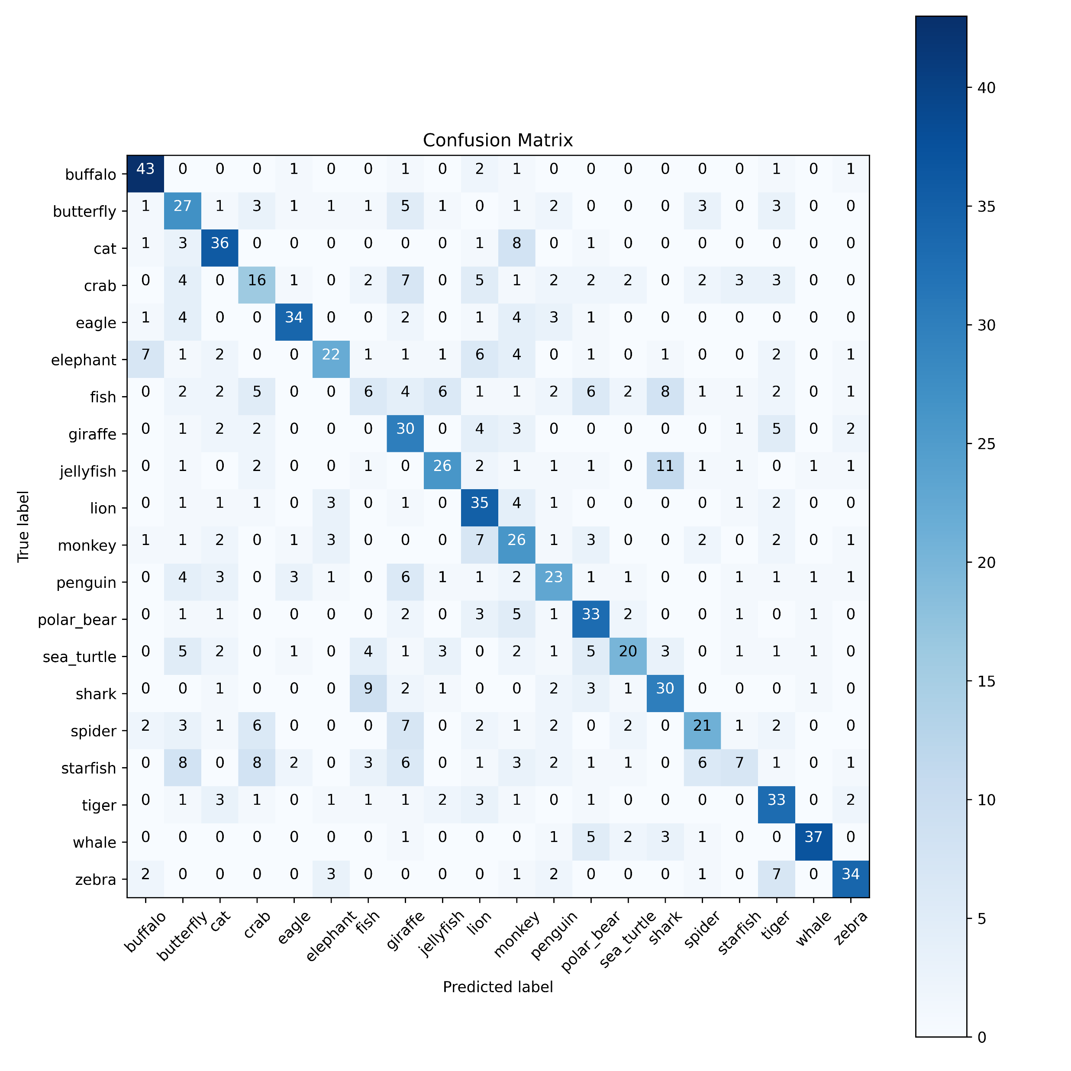
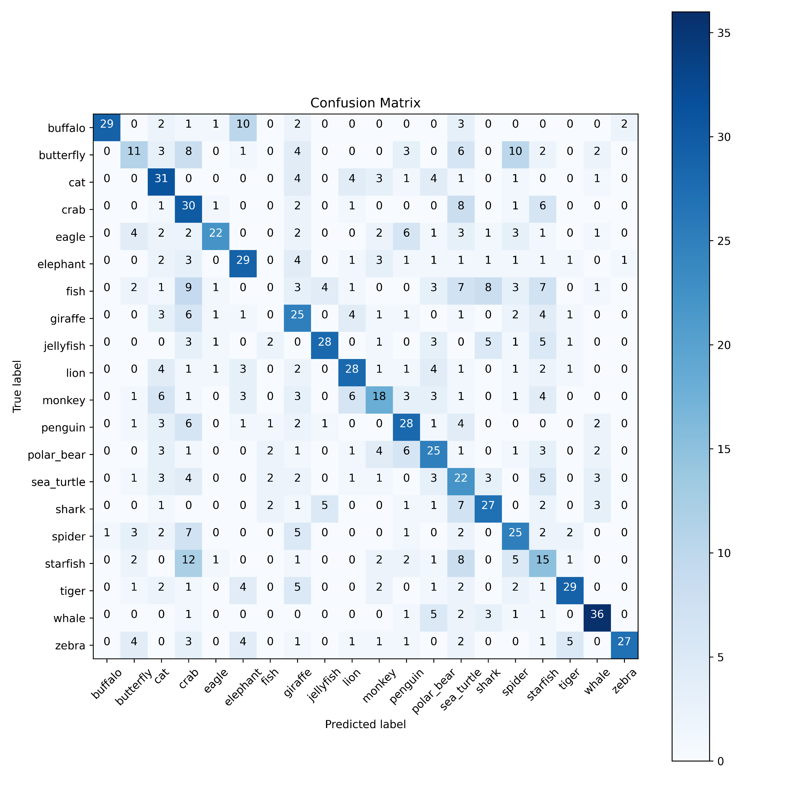
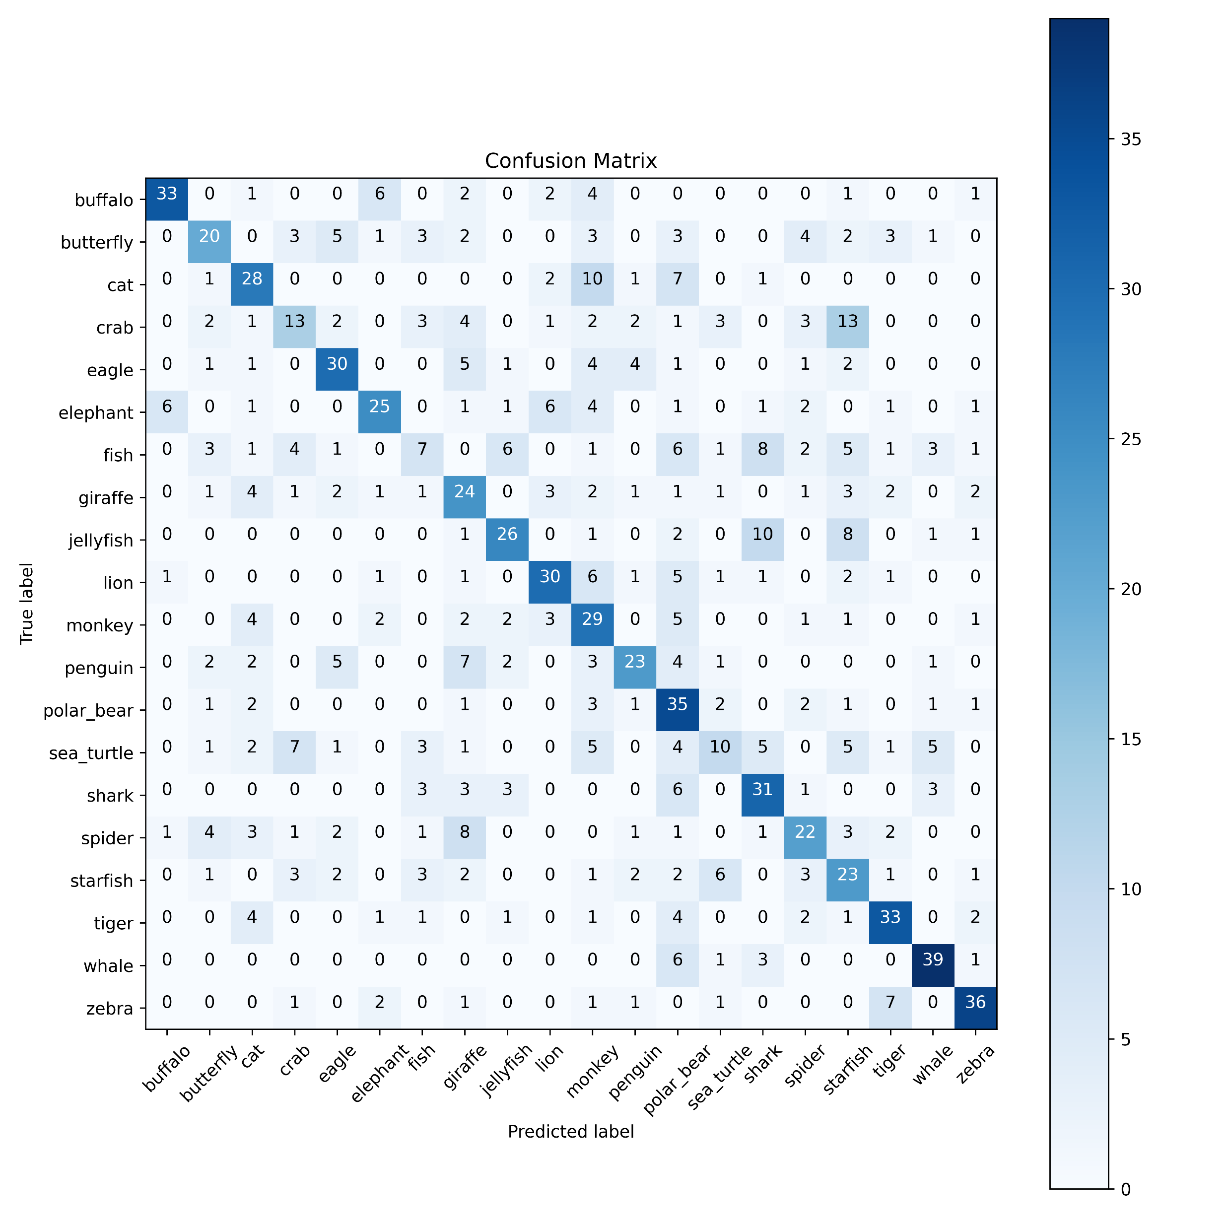
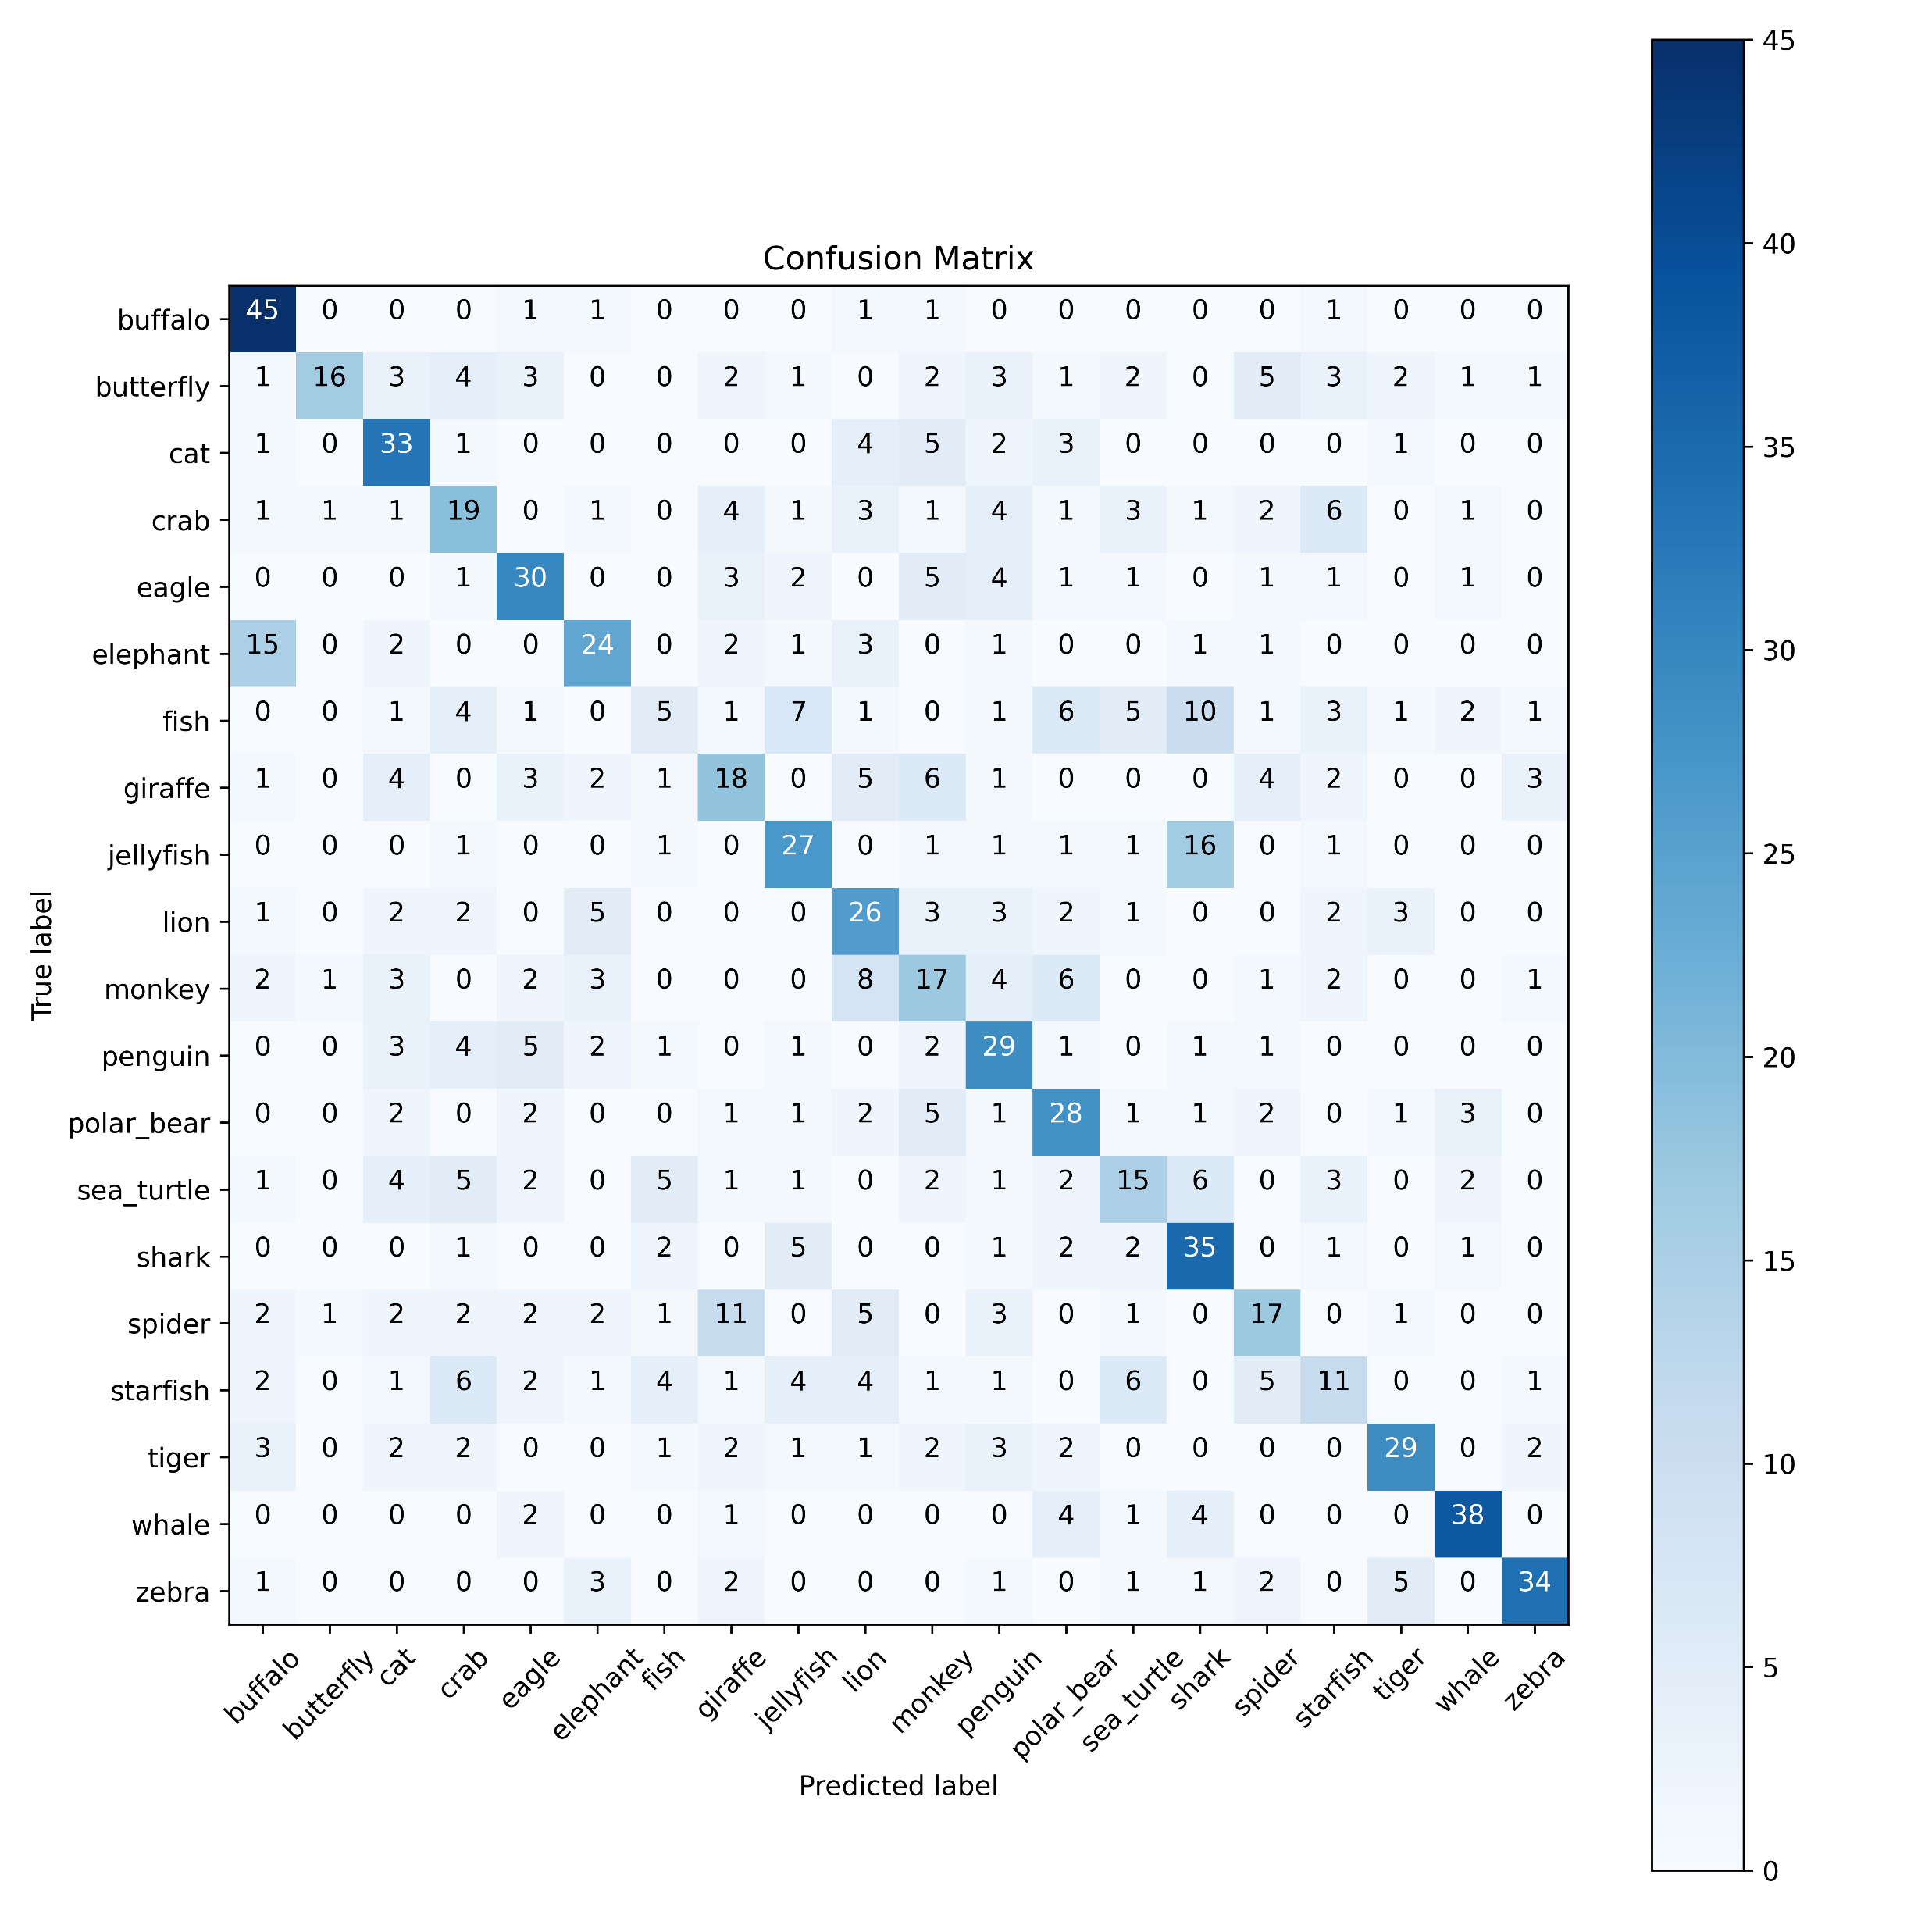

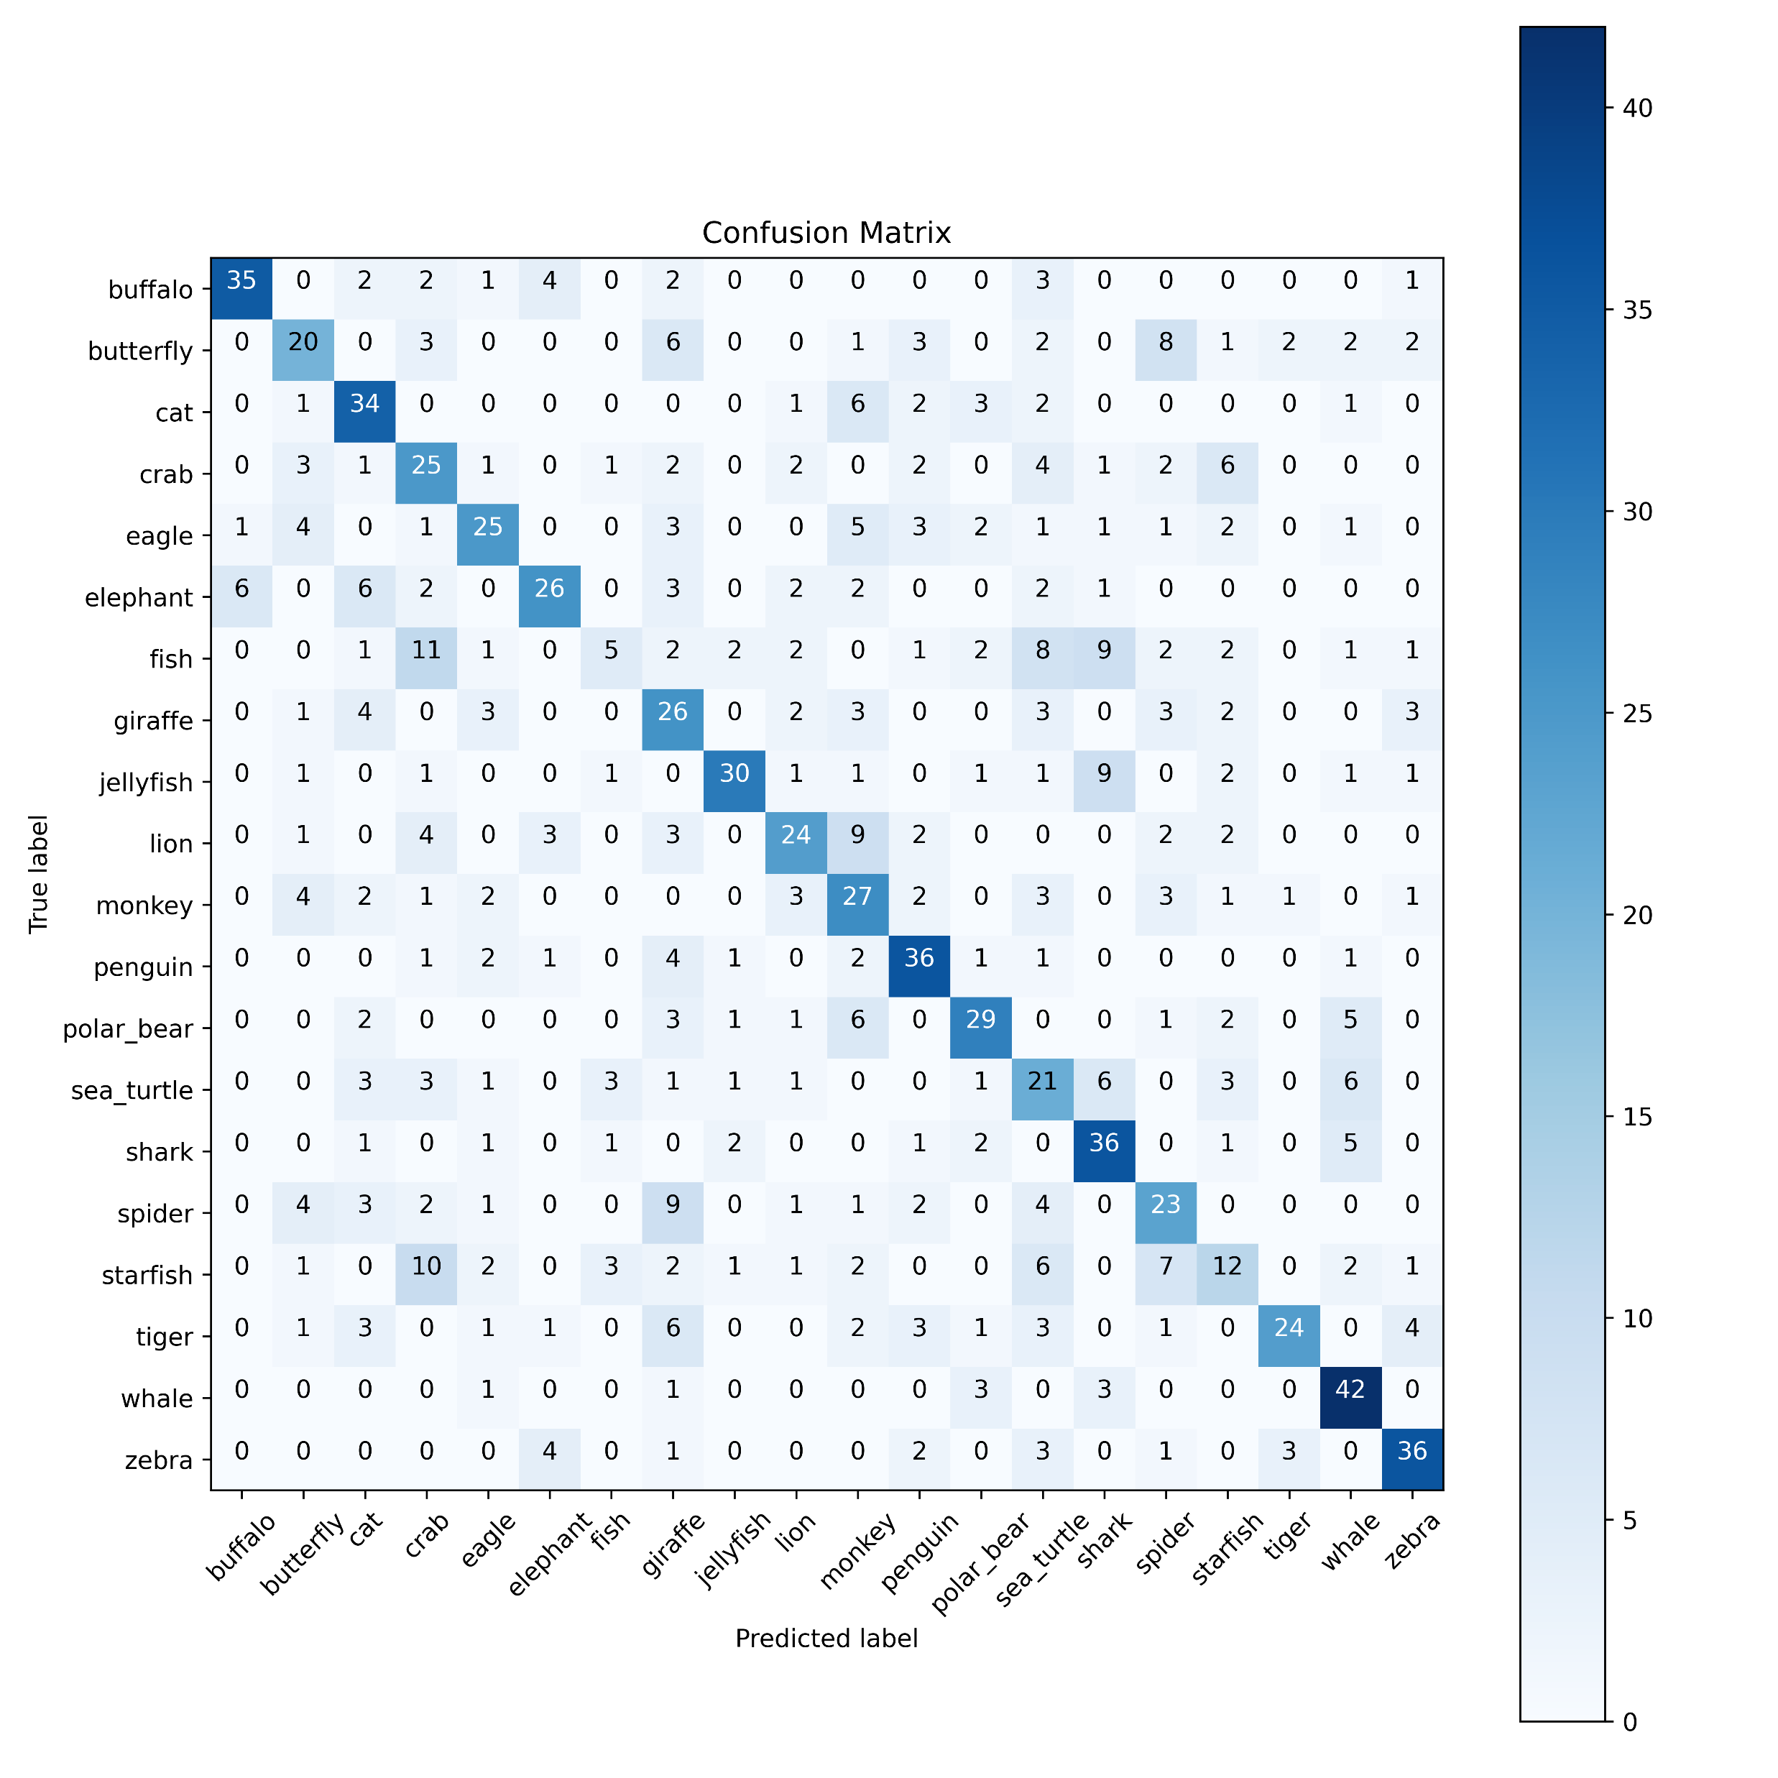
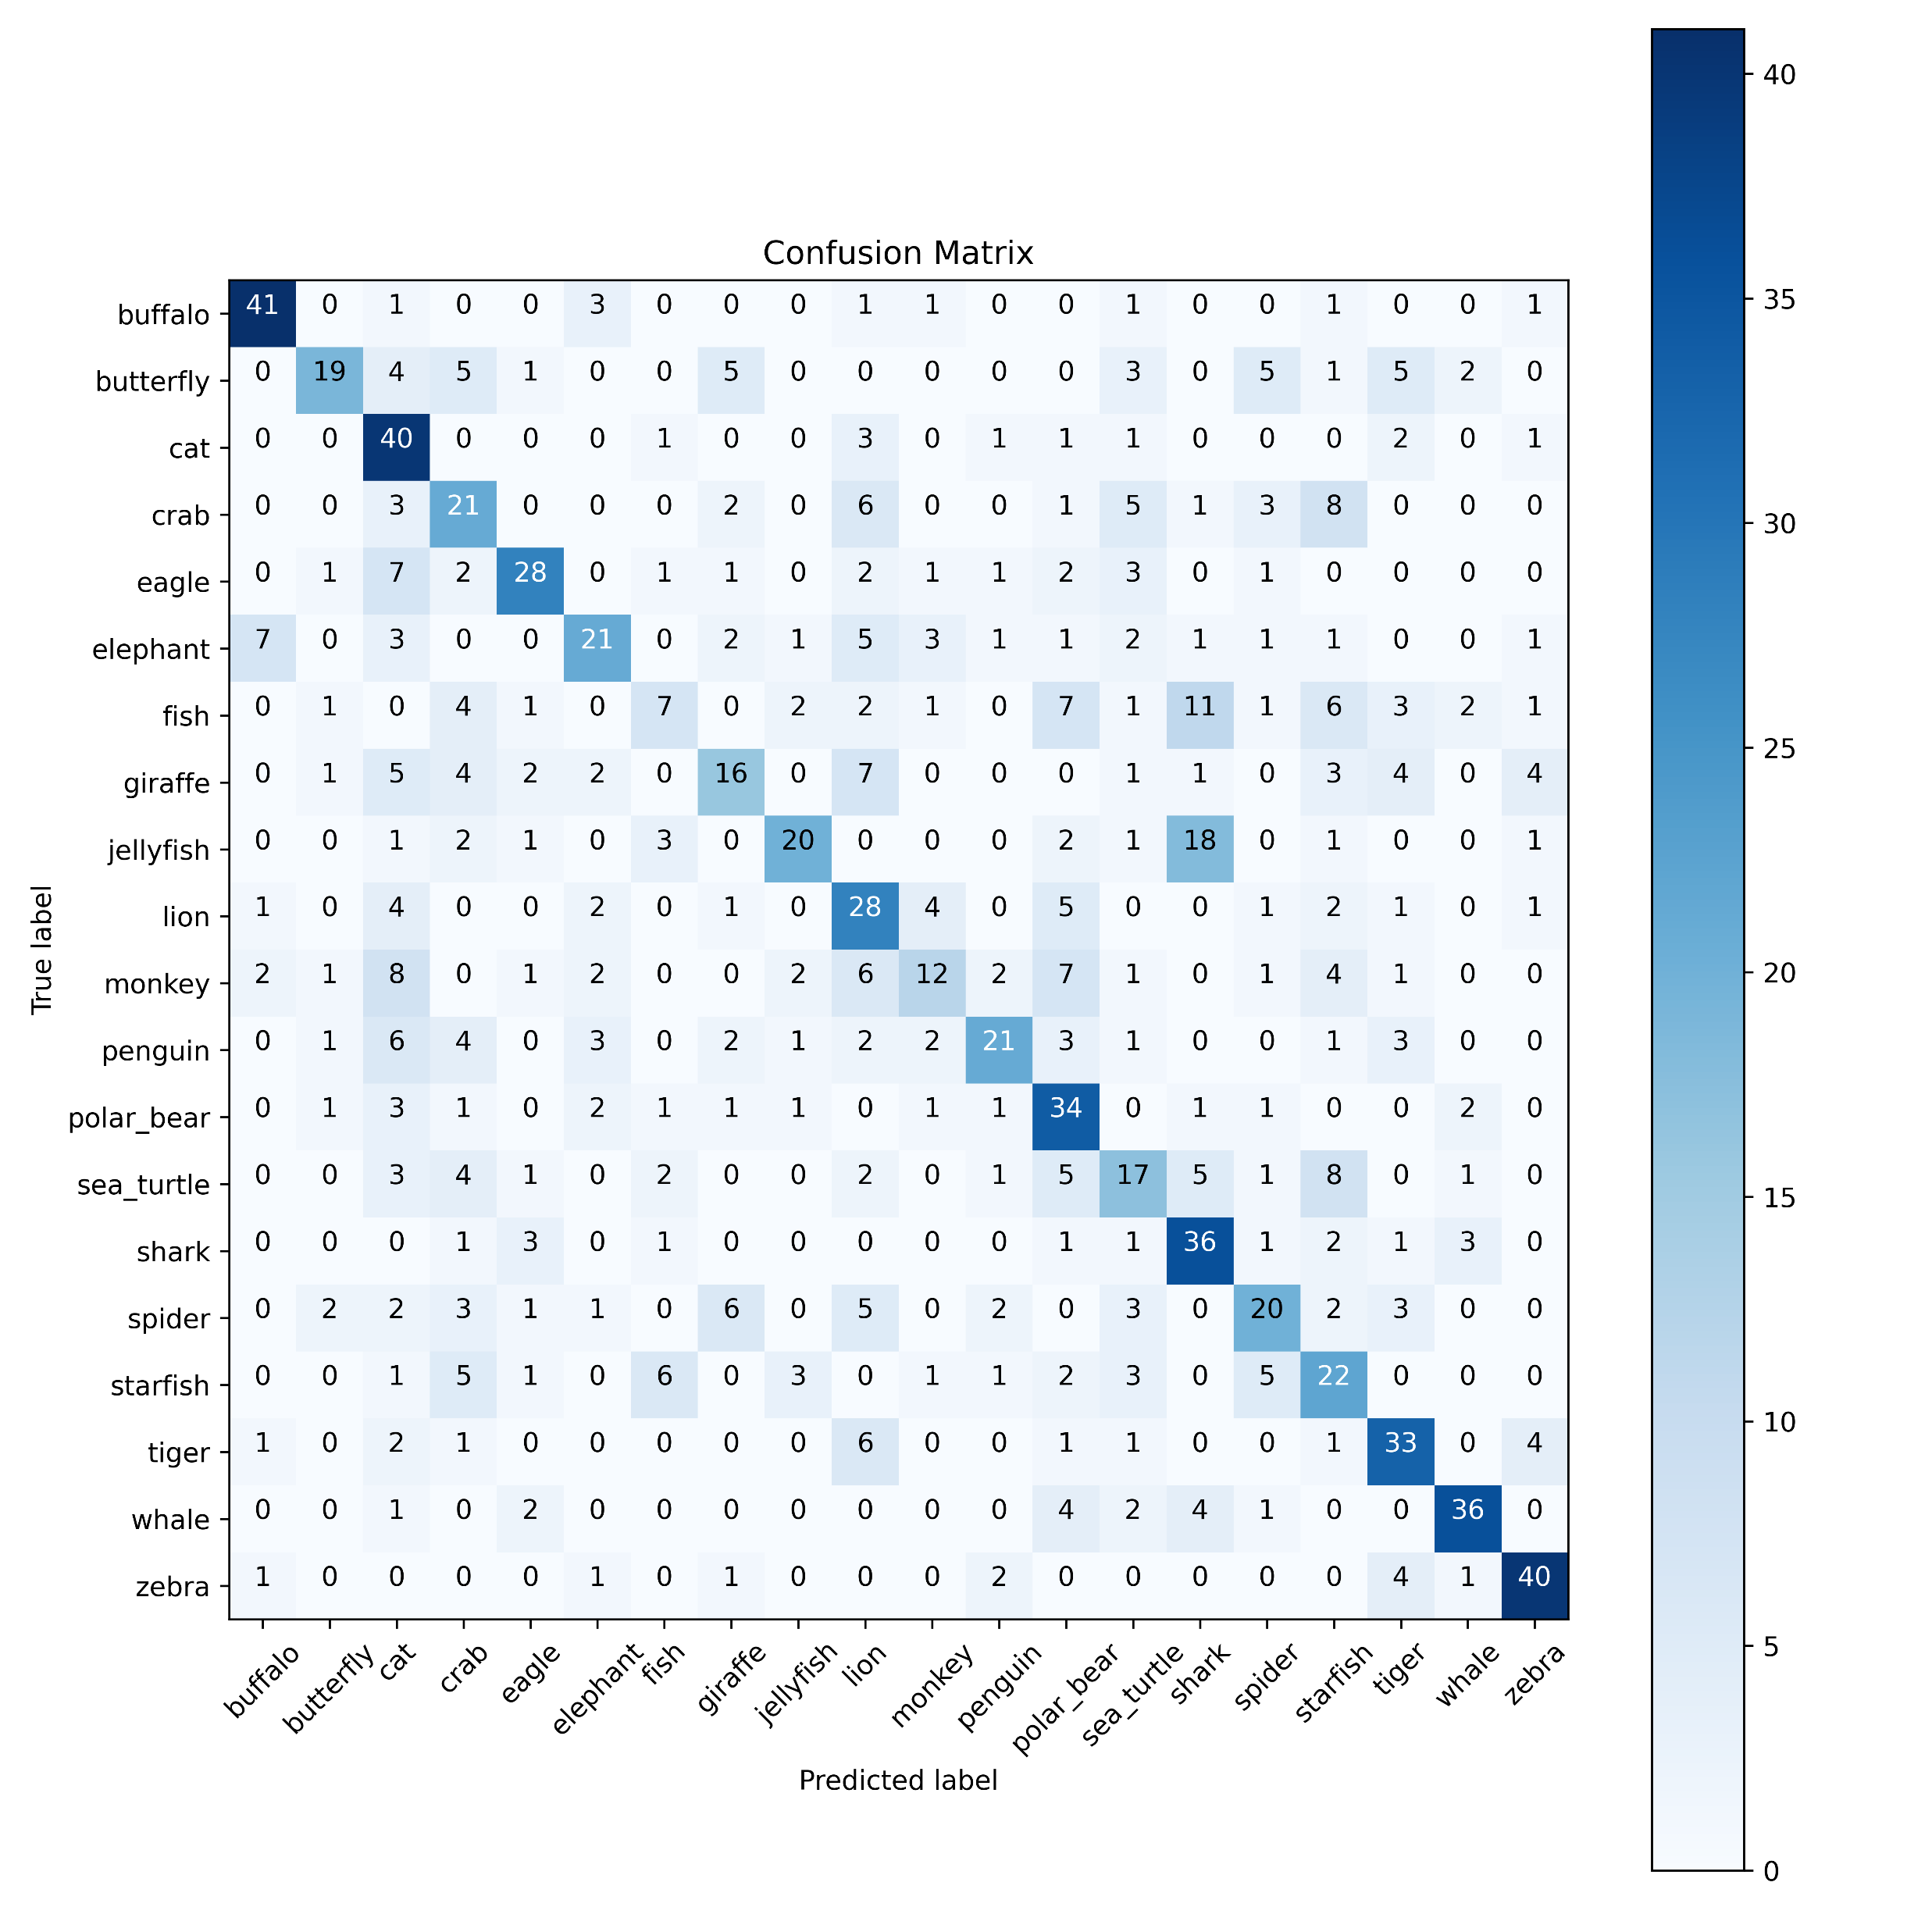
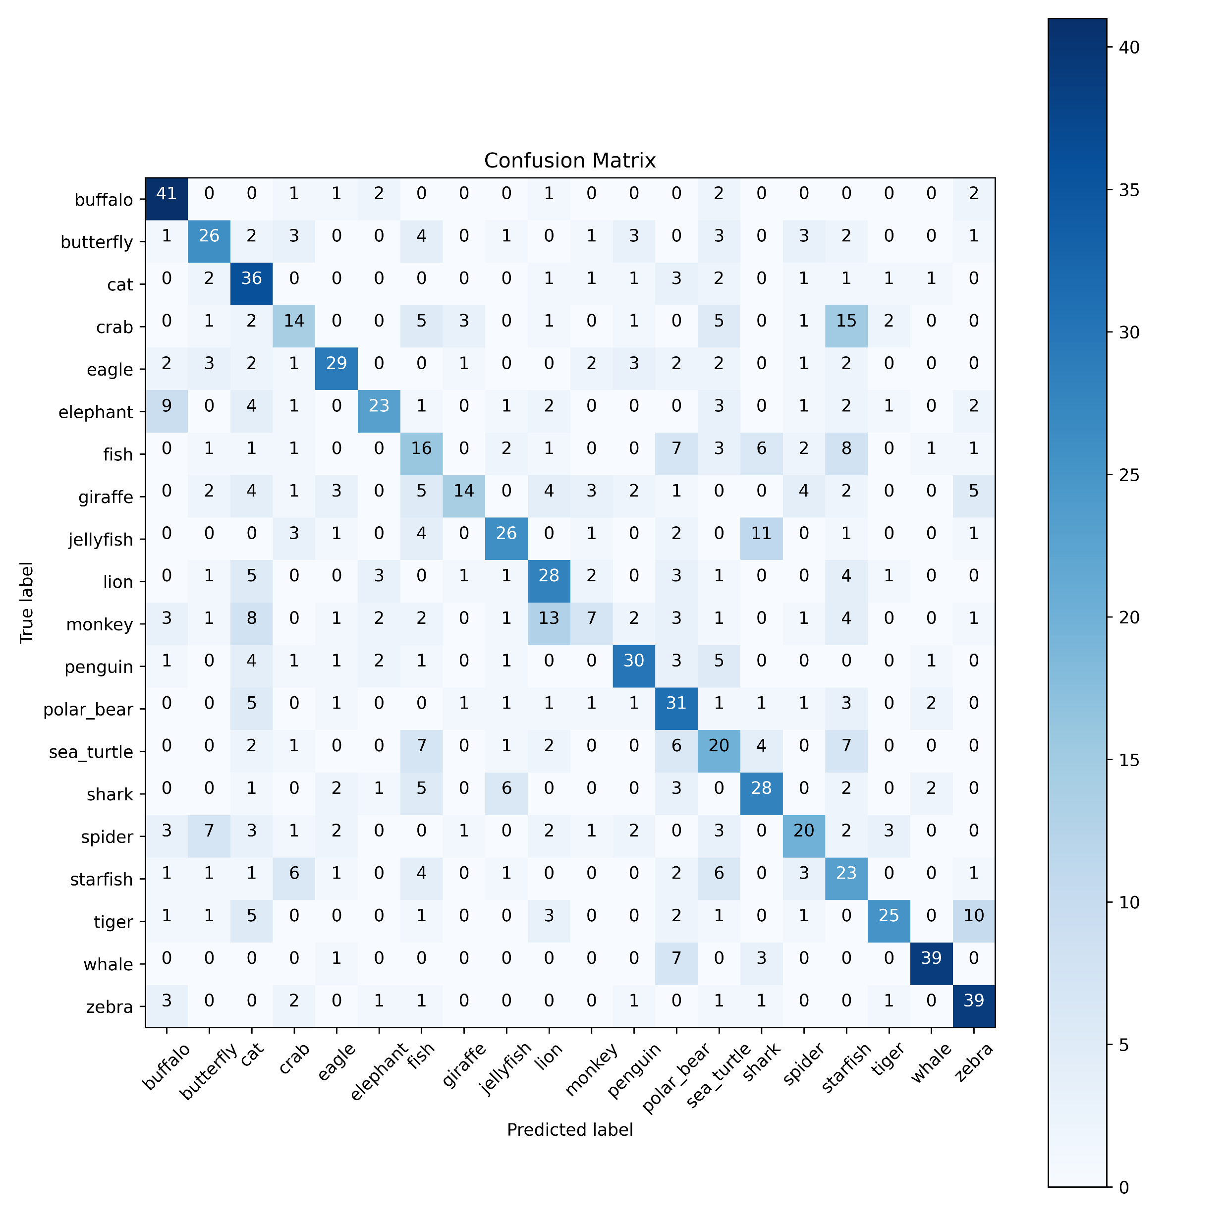
Confusion Matrices
Dropout: 0.0, BN: False
Dropout: 0.2, BN: False
Dropout: 0.3, BN: False
Dropout: 0.4, BN: False
Dropout: 0.5, BN: False
Dropout: 0.0, BN: True
Dropout: 0.2, BN: True
Dropout: 0.3, BN: True
Dropout: 0.4, BN: True
Dropout: 0.5, BN: True

Slide 14
Thank You

